Slide 1



Online Privacy and the Upcoming
Children's Online Privacy Code
Primary Schools

Slide 2

Lesson focus
Part A
The following classroom activity has been designed to help children and young people:
  develop an understanding about online privacy and why it is important; and
  learn about the Children's Online Privacy Code and provide feedback on it.

Slide 3


Why does online privacy matter for children and young people ?
Zara is standing at the traffic lights waiting to cross the road with her mum. As a bus passes, Zara and her mum notice a huge advertisement featuring a picture of a child. To their shock, the child is Zara! The image came from Zara's gaming profile. She doesn't know how it ended up on the bus.
If someone can use Zara's photo like this, they could use yours too. Online privacy matters because once information is shared, it can be difficult to control where it goes.

Slide 4
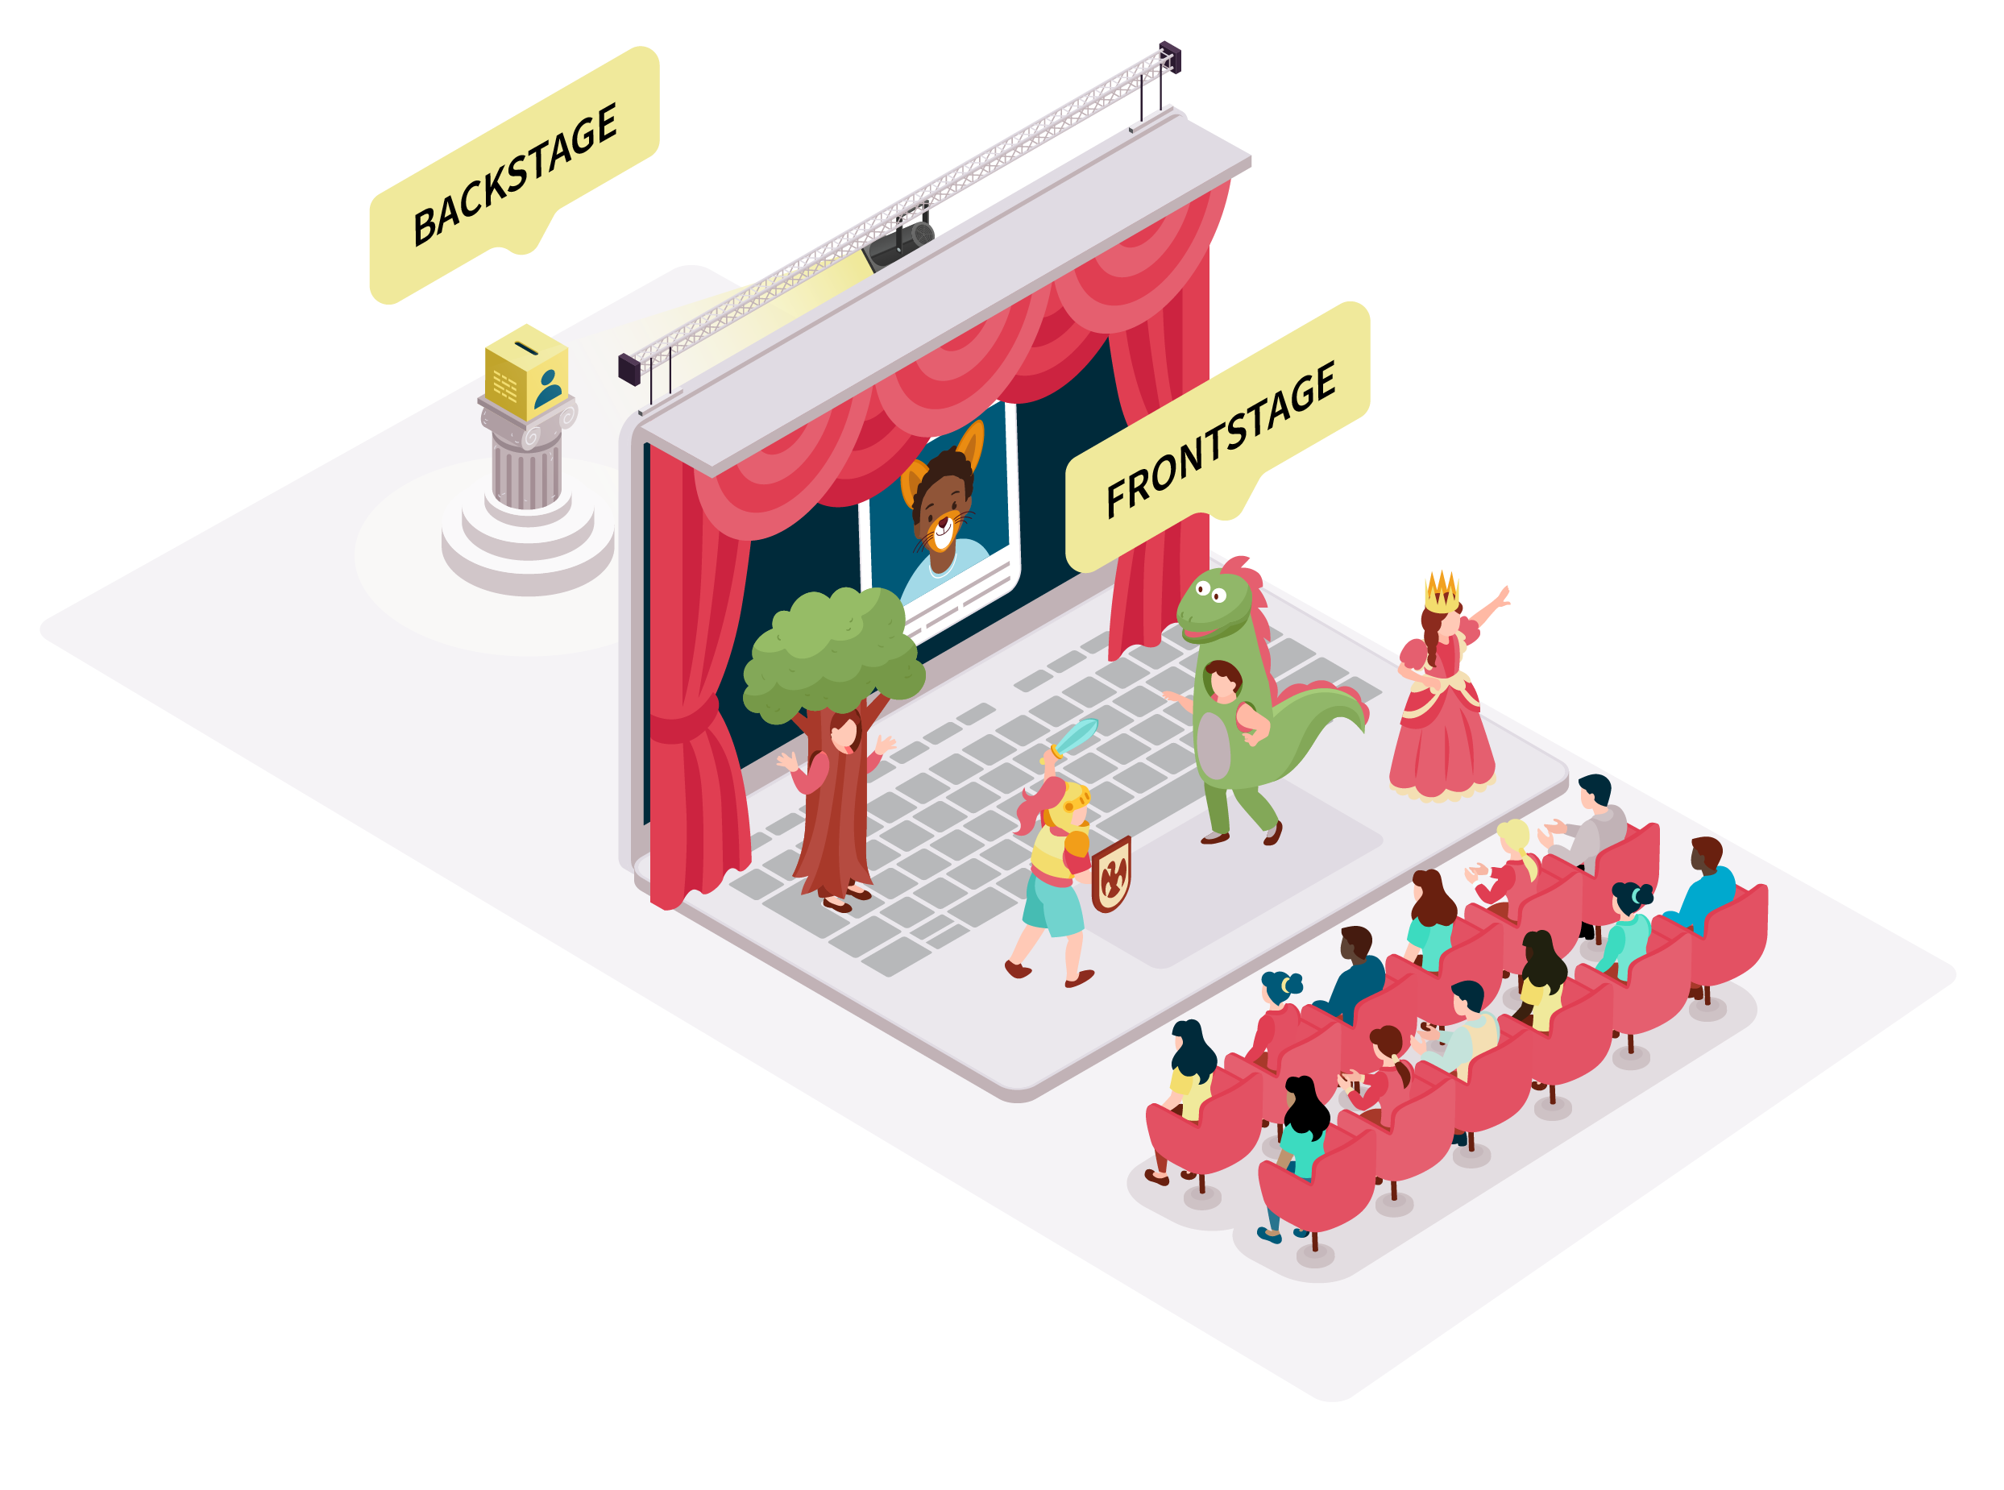
What is Online Privacy?
Think about online privacy like a stage where you watch a school assembly or a music concert.
There is a frontstage and
backstage that are separated by a curtain.
Frontstage: In front of the curtain, where everyone in the audience can see what is happening (e.g. social media posts).
Backstage: Behind the curtain, where only the people running the show can see what is happening (e.g. location information).

Slide 5

Who are the OAIC?
The Office of the Australian Information Commissioner (OAIC) is the Australian Government’s privacy regulator.
The OAIC protects the privacy of Australians.
You can think of them as the 'Privacy Police'.
The OAIC is responsible for writing the Children’s Online Privacy Code.

Slide 6

What is the Children's Online Privacy Code?
Why should we have one?
The Code is a special set of privacy rules that many online services (like apps, games, and websites) will need to follow to help take better care of children's personal information online.
Protecting your personal information online is one important step to protecting
your online privacy.

Slide 7

Online privacy and the Children's Code
The Code focuses on protecting children and young people's online privacy – that means you!
It does this by:
  helping you to understand what happens to your personal information behind the curtain,
  telling online services how to take care of children’s personal information, and
  giving you more control over what happens to your personal information online.

Slide 8
Time to have your say - what do children and young people think?
Part B
The Office of the Australian Information Commissioner (OAIC) wants to know what you think. They have prepared a series of questions to gather feedback from children, young people and schools on the Code.
You will be asked to choose one of three options:
Like
Dislike
Neither like nor dislike
The following slide includes some key vocabulary to help
you understand the questions. You can find other key
terms via the OAIC webpage: www.oaic.gov.au/keyterms

Slide 9
Vocabulary in the Code
Online activity means the things that you do online, for example who you message, who messages you, whether you buy something online, what photos and videos you look at a lot.
Online services are things like an online app, game or website.
Permission When you say yes or no to an online service asking if you can give personal information (This is also known as 'Consent').
Personal Information Information about who you are or what you do, including things like your name, address, email, phone number, school, date of birth, photos or videos of you, location, and online activity.

Slide 10

Rule 1: Many online services will need to follow the rules in the Code
These include online services:​
  that you use in your daily life, like messaging apps, games, and education websites, and​ education websites, and
  that the adults in your life use to record and share personal information about you, like school apps used by teachers to message your parents or apps that parents use to track their babies’ sleep.
Once the Code is in place, many online services that you use AND ones that you do not use but the adults in your life use to share your personal information, will need to follow the rules in the Code.​
​
This means that even online services that aren’t made for you, or used by you, will need to follow the rules in the Code.
How do you feel about Rule 1?
Like 🙂 | Dislike ☹️ | Neither 😐 like nor dislike

Slide 11
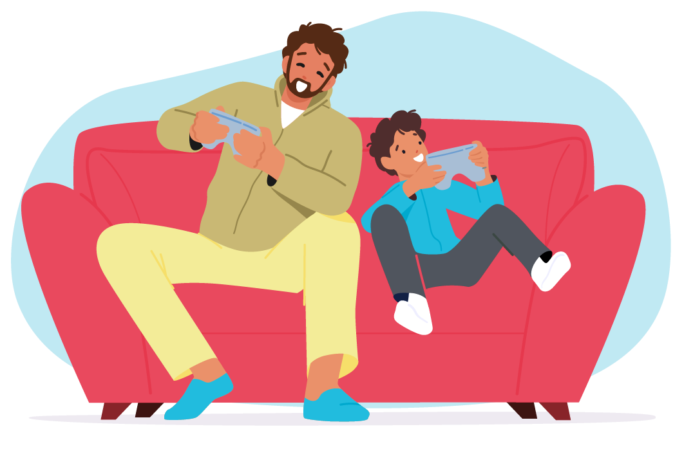
Rule 2: To protect your personal information, online services have to either give everyone better privacy protections or check your age
If the online service is used by both children and adults, the online service can either give adults the same privacy protections as children or check your age. Checking your age will not stop you or limit your use of the online service but it will make sure that the online service is taking care of your personal information in the right way.
Once the Code is in place, online services need to make sure that these rules apply to children's personal information. ​
This means that online games will need to make sure they have the right privacy protections in place.​ If the game is not going to apply the same protections to adults as they must for children, they might need to check your age before you ​play the game.
​
Checking your age will not stop you or limit your use of games, but it will make sure that the game is taking care of your personal information in the right way.
How do you feel about Rule 2?
Like 🙂 | Dislike ☹️ | Neither 😐 like nor dislike

Slide 12
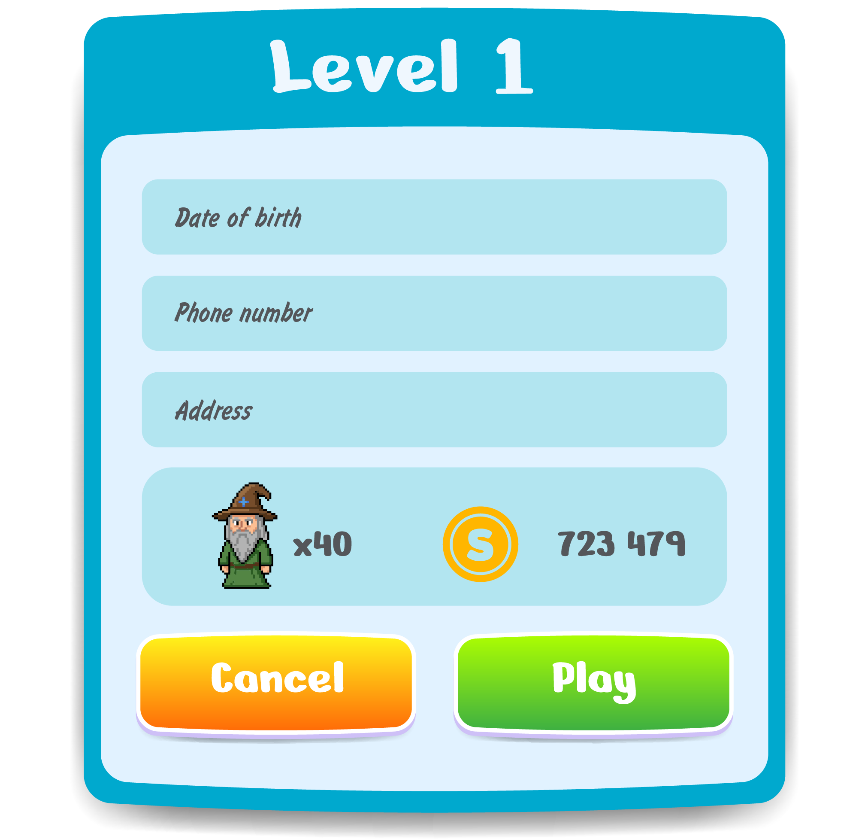
Rule 3: Online services can only collect, use or share the bare minimum amount of your personal information they need to run the app, game or website unless you choose differently
Online services can do this by raising the standard when it comes to privacy protections and giving you (and your parent or carer) the control to change your privacy settings to share more personal information, if that is what you want
Once the Code is in place, online services will give you more control over your personal information by giving you (and your parent or carer) the choice to change your privacy settings to share extra personal information (more than the bare minimum to run an app, game or website), if that is what you want.​
​
This means that online games will need to raise the standard when it comes to their privacy protections and only collect, use or share the bare minimum amount of personal information they need to run the game, unless you
(and your parent or carer) choose differently. ​
How do you feel about Rule 3?
Like 🙂 | Dislike ☹️ | Neither 😐 like nor dislike

Slide 13

Rule 4: Online services need to be fair and take care of your personal information in a way that is best for you
When online services collect, use or share your personal information it must be in your best interests (meaning it is best for you and fair).
Once the Code is in place, online services must stop and think about if what they do with your personal information (like show ads that are​ specially for you) is what is best for you. ​
​
This means that online games and services will need to ask themselves if it is fair to show you ads that have been specially picked just for you.​ If the answer is that it is unfair and not in your best interest, the online service must not use or share your personal information to figure out what ads​ they should be showing you. ​
How do you feel about Rule 4?
Like 🙂 | Dislike ☹️ | Neither 😐 like nor dislike

Slide 14

Rule 5: Online services need to ask for your permission to do things with your personal information
If you are 15-years-old or older, you can make your own decisions about your personal information online. Online services can go to you directly to ask for your permission.​
If you are under 15-years-old, your parent or carer will need to be asked for permission to make decisions about your personal information online.
Once the Code is in place, if you are 15 years-old or older, online services no longer need to get permission from your parents or carers to collect, use, or​ share your personal information. They will now go straight to you, and you can give permission by saying either ‘yes’ or ‘no’.​
​
If you are under 15-years-old, online services will need to ask your parent or carer for permission to make a decision about your personal information​ online by either saying ‘yes’ or ‘no’.​
How do you feel about Rule 5?
Like 🙂 | Dislike ☹️ | Neither 😐 like nor dislike

Slide 15
Rule 5: Online services need to ask for your permission to do things with your personal information
If you think that Rule 5 should have a different age, what age do you think children should be allowed to give permission without their parents or carer's permission?​
12
13
14
15
16
17
18+

Slide 16

Rule 6: If you are under 15-years, in some situations online services will need to involve both you and your parent, to get permission to change your privacy protections
If you choose to allow an online service to:​
  use or share your personal information for some reason beyond the bare minimum to run the app, game, or website (like to show you ads that have been specially picked, just for you), or​
  collect sensitive information (which is personal information that needs to be treated extra carefully, like your health information).
Once the Code is in place, online services will need to tell you what making a change will do, it will then ask you if it’s okay to email your parent or carer (or let them know some other way) to tell them that you have asked for a change in your privacy​ settings. It is then up to your parent or carer to give the final ultimate permission by saying
either ‘yes’ or ‘no’, for that change to happen.​​
​
This means online apps will need to ask permission in a way that involves both you and your
parent or carer, if the app wants to use​ or share your personal information in a specific way.
How do you feel about Rule 6?
Like 🙂 | Dislike ☹️ | Neither 😐 like nor dislike

Slide 17

Rule 7: Online services must not trick you into giving them permission
Online services must not deliberately trick, confuse, or pressure you into giving permission to collect, use, or share your personal information. This means online services cannot do things like be sneaky and hide buttons that give you a choice to say 'no'.
Once the Code is in place, online services will not be allowed to trick you and take advantage of your fear of missing out, to pressure you to say ‘yes’ and hand over your personal information that you do not want or need to share.​
​
This means that websites will not be allowed to trick, confuse, or pressure you into giving them permission to collect your personal information.
How do you feel about Rule 7?
Like 🙂 | Dislike ☹️ | Neither 😐 like nor dislike

Slide 18

Rule 8: Online services must make sure that the permission they get from you (or your parent or carer) is 'good' permission
When online services ask for your permission to collect, use or share your personal information online, they need to tick the 6 boxes below for that permission to be 'good' permission:​
  Without pressuring, tricking or confusing you into making a decision (voluntary),​
  Give you all the right information you need to make a decision (informed), ​
  Ask you often and at the right times because permission does not last forever (current), ​
  Make sure that you know that you are allowed to take back your permission at any point (be withdrawn), ​
  Make sure that you understand ‘why’ they need your personal information and ‘what for’ (specific),
  Make sure that you have clearly agreed and given your permission with a solid ‘yes’, because when you say ‘maybe’ or nothing at all, it is a ‘no’ (unambiguous).
This means that when websites do not tick the 6 boxes, they did not do the right things to get ‘good’ permission from you.
How do you feel about Rule 8?
Like 🙂 | Dislike ☹️ | Neither 😐 like nor dislike

Slide 19

Rule 9: Online services must make sure you can access and understand what they do with your personal information
Online services must make sure that their privacy policies and any notices that 'pop up' that tell you what they do with your personal information, is child-friendly. That means they need to be easy to read and understood by you (no big words!) .
Online services must make it easy for you to find the instructions on the app, game or website that tell you how to ask for what personal information the online service knows about you.​
Online services must make it easy for you and your parent or carer to ask for what personal information is known about you and what the app, game or website does with it.​
Online services must make it easy for you to ask them to stop showing you ads that have been specially picked, just for you and the main goal of the ads are to get you to buy things.
Once the Code is in place, online services must tell you the important things about your online privacy in a way that is easy to find and​ easy to and easy to understand. Online services must also make it easy for you and your parent or carer to ask to see what personal​ information an online service has about you.​
How do you feel about Rule 9?
Like 🙂 | Dislike ☹️ | Neither 😐 like nor dislike

Slide 20

Rule 10: Online services must answer you within 30 days (in most cases) if you ask to see, change or delete your personal information
Online services must respond to you (or your parent or carer) within a fair amount of time, if you ask to see, change or delete what personal information they know about you. If it takes longer than 30 days, the online services must explain to you why it is going to take longer.
Once the Code is in place, online services must answer you within 30 days. If it is going to take a bit longer because there is lots of information for them to go through, that’s allowed, but there must be a good reason for it and they must explain that reason to you.​
​
This means that online apps will need to answer your questions within 30 days, and if they look at your questions and decide that it is going to take longer than that, they must let you know and explain the reasons why it is going to take a longer time.
How do you feel about Rule 10?
Like 🙂 | Dislike ☹️ | Neither 😐 like nor dislike

Slide 21
Rule 11: Online services must delete your personal information if you (or your parent or carer) ask for it to be permanently deleted
You can now ask an online service to permanently delete the personal information they have collected about you, and they have to do it unless there is a good reason they cannot (like a law says that they can’t).
Once the Code is in place, you will be able to go directly to online services and ask them to permanently delete all records of your personal information.​ If the online service does not have a good reason to say no (like a law stops them), they have to say ‘yes’ and delete your personal information forever from their records.​
​
This means online apps will need to delete your personal information if you or your parent or carer asks (unless there is a law that stops them).​ Once your personal information has been deleted forever, they need to tell you it has been done.​
How do you feel about Rule 11?
Like 🙂 | Dislike ☹️ | Neither 😐 like nor dislike

Slide 22
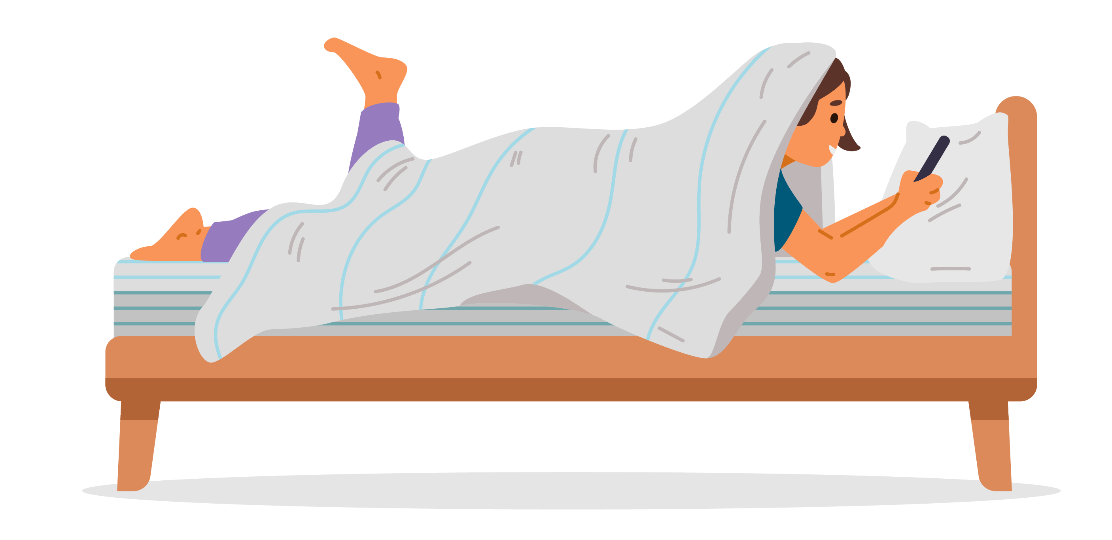
Rule 12 (Part 1): Online services must tell you when your physical location can be seen by other people and parental controls are being used
Online services must tell you if your parent or carer can see your physical location or can see or control the activity that you are doing when using an app, game or website.
Once the Code is in place, online services must tell you if your parent or carer can see your online activity (including your physical location) while you are using the app, game or website.​
​
This means online services, like messaging apps, will need to make it known to you that your parent or carer can see your online activity (including your physical location) when you are using the service.​​
How do you feel about this part of Rule 12?
Like 🙂 | Dislike ☹️ | Neither 😐 like nor dislike

Slide 23

Rule 12 (Part 2): Online services must tell you when your physical location can be seen by other people and parental controls are being used
Online services must also tell you if and when another user of the same online service can see where your physical location is by tracking your device (like your phone, tablet or smart watch).
Once the Code is in place, online services must tell you if another user of the online service can see your physical location, by tracking your device (like a phone, tablet or smart watch). Online service must tell you as soon as the location tracking starts and when the tracking is happening.​
​
This means that online messaging apps will need to make it known to you if and when any other user of the same service can see your physical location.​
How do you feel about this part of Rule 12?
Like 🙂 | Dislike ☹️ | Neither 😐 like nor dislike

Slide 24

Rule 13: Online services must make it easy for you to ask questions and complain if there is a problem with your personal information
Online services must give you all the information you need in a way that you can understand, so that if you have questions or something goes wrong in how they have collected, used, or shared your personal information, you feel like you can easily ask a question or tell the online service that there is a problem (this is called, ‘making a complaint’).​
Once the Code is in place, online services must make it easy for you to ask questions so that if something goes wrong in how they have collected, used, or shared your personal information, you feel like you can easily tell the online service that there is a problem (this is called, ‘making a complaint’).​
​
This means that online apps will need to make it easy for you to ask questions and get the help you need.​
How do you feel about Rule 13?
Like 🙂 | Dislike ☹️ | Neither 😐 like nor dislike

Slide 25

Rule 14: Online services will need to think and plan before they act
Once the Code is in place, online services will need to plan (stop, think, write and record) how they will protect children’s online privacy before they add extra functions to their app, game or website.​
​
Online services will also need to make their plan available for others to see (like the OAIC) and make sure that the people who work for the online service who look at your personal information often, are trained to protect children's online privacy.​
​
This means that websites won’t be able to rush into anything new or change the way they collect children’s personal information, without planning how they will protect children’s online privacy before they add extra functions to the app, game or website.​
How do you feel about Rule 14?
Like 🙂 | Dislike ☹️ | Neither 😐 like nor dislike

Slide 26
Reflections on the Code and your Online Privacy
Which rules do you think will have the greatest impact on your online privacy?
Do you think the Code will change the ways online services collect, use and/or share your personal information?
Is there anything more you would like to see the Code do now and in the future?
How will your online experience change with the introduction of these rules?

