Slide 1

Children’s Online Privacy Code
Public Consultation Workshop

Slide 2
We acknowledge the traditional Owners of Country throughout Australia and their continuing connection to land, waters and community.
We pay our respects to the people, cultures and the Elders past and present.
Notes:
Acknowledgement of country
Housekeeping items

Slide 3
Contents [REMOVE slide before presenting]
0
Guide to presenting this workshops agenda including instructions and resources
1
Overview of the Children’s Online Privacy Code (the Code)
2
Activity 1: What is online privacy?
3
Activity 2: Scenario-based activity for each rule

Slide 4
Guide for Facilitators presenting
[REMOVE slide before presenting]
The OAIC recognises the importance for children and young people to receive real-time support while participating in the public consultation.
To this end, we welcome the support of educators and facilitators to help children and young people participate in the draft Code consultations.
Thank you for facilitating an in-person or virtual workshop to support children and young people’s participation in the consultation.
Learn more about the about the Children’s Online Privacy Code Privacy for Kids – Children’s Online Privacy Code | OAIC

Slide 5
Guide for Facilitators presenting
[REMOVE slide before presenting]
This presentation is:
recommended for primary school aged children, aged 8 to 12-years old
The workshop should take around 60 minutes
Please take more or less time depending on your group
Please adapt the format of this presentation to support your group’s unique needs (you know your group best!)
Additional resources about the draft Code that can support facilitating this workshop, can be accessed at www.oaic.gov.au/privacyforkids

Slide 6
Guide for Facilitators presenting
[REMOVE slide before presenting]
Instructions:
Plan and coordinate to run a consultation workshop between 31 March and 5 June 2026.
Step 1. Remove these 4 instructional slides before the presentation
Step 2. Read out the introductory information about the draft Code and online privacy
Step 3. Run Activity 1. What is online privacy? (Eg., facilitate a ~5min group discussion about online privacy)
Step 4. Run Activity 2. Scenario-based activity for each rule of the Code
  Step 4.1: Have open and complete the online form: Educators and Facilitators - Years 3-6: Primary school aged children (recommended) This is where you will record the group’s answers. This form also contains more explanatory information about the Code, which can support your facilitation of this workshop.
  Step 4.2: Record how many children either 'like', 'dislike', or 'neither like nor dislike’ each rule
  (e.g., ask for ‘hands-up’, add token to jars, start a tally on the board etc. be creative!)
  Step 4.3: (Optional) Record a summary about why the group either 'like', 'dislike', or 'neither like nor dislike' for each rule
Step 5. Submit online group form

Slide 7

What is the OAIC?
The Office of the Australian Information Commissioner (OAIC) wrote this presentation.
The OAIC is the Australian Government’s privacy regulator and their goal is to protect the privacy of Australians.
The OAIC is responsible for writing the Children’s Online Privacy Code.
When the OAIC refer to ‘children’ they mean people under the age of 18.
Carly Kind,
Privacy Commissioner

Slide 8
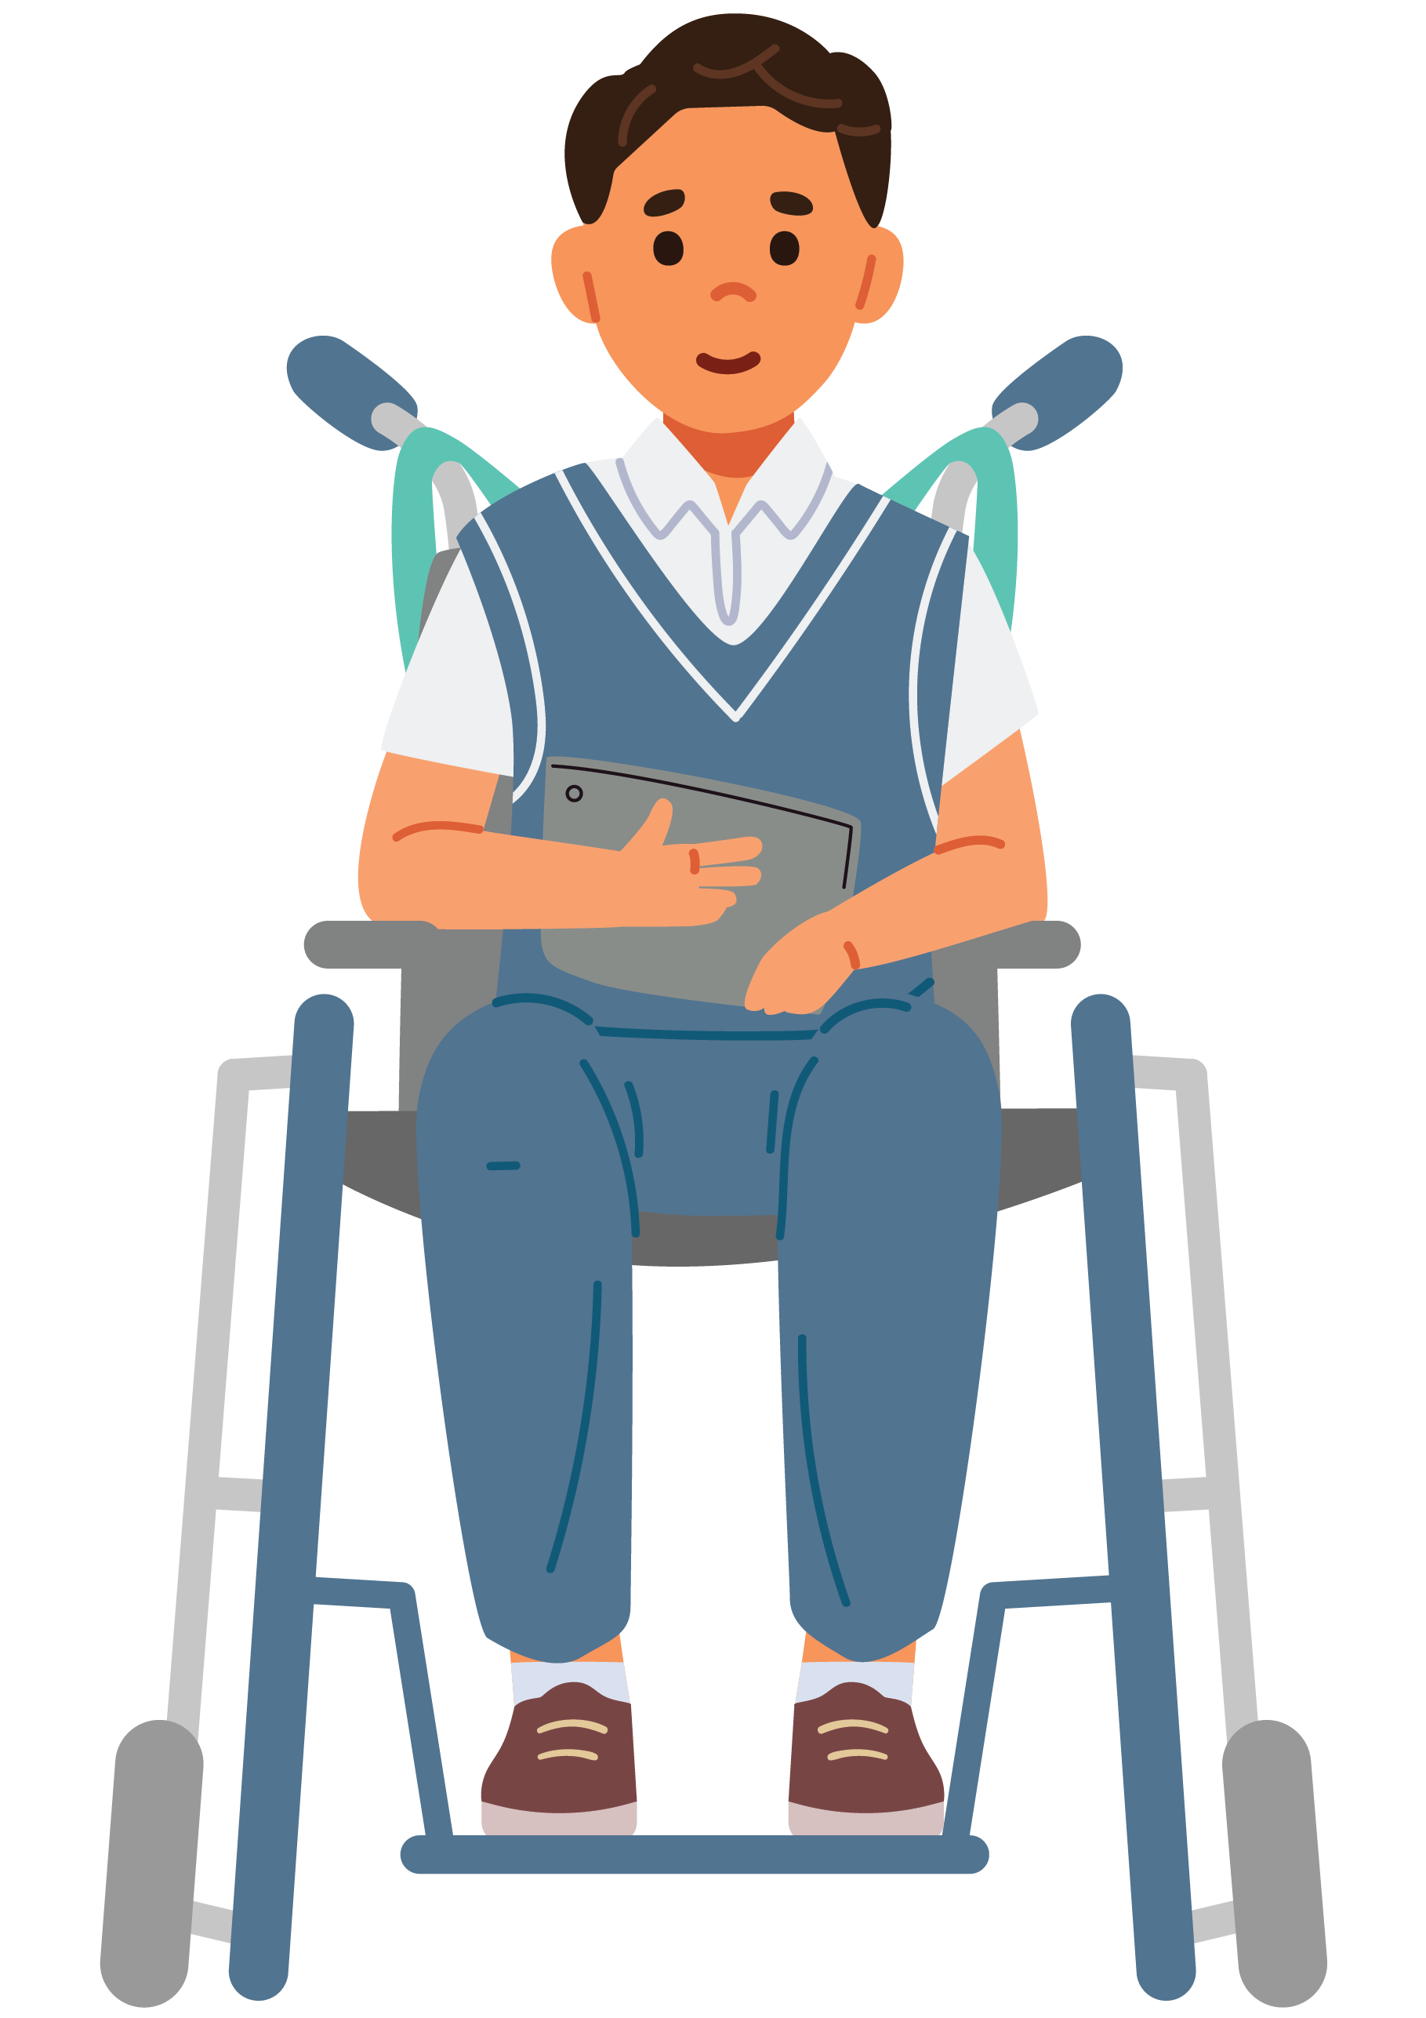
What is the Children’s Online Privacy Code
The Children’s Online Privacy Code (the Code) creates special rules for online services that will help protect the privacy of children when using the internet.
The Code will apply to many apps, games, and websites that are used by children or collect personal information about children.
Personal information is things like your name, address, email, phone number, school, date of birth, photos or videos of you, location, and online activity.
This new Code will help protect children's online privacy by telling many online services how they need to follow special privacy rules when taking care of children’s personal information online.

Slide 9
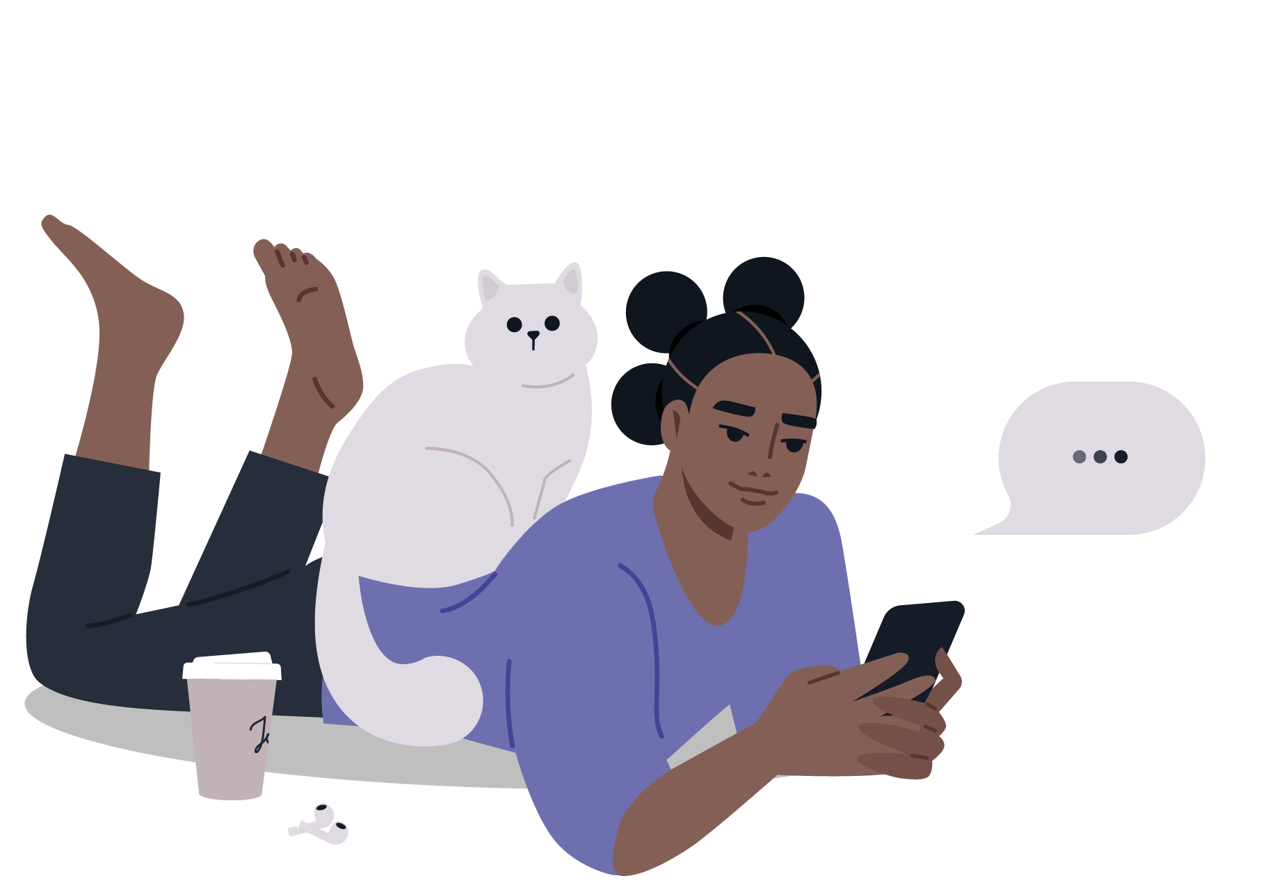
Why do we need a privacy code for children?
We need special online privacy rules to protect children’s privacy because many online services like apps, games, and websites collect children’s personal information from a young age.
When online services follow the Code, you will be given the chance to learn more about what happens to your personal information online.
This will allow you and your parents or carers the ability to choose what personal information you want to share with the online service.
This gives you and your parents or carers more control of your personal information.
Having more control about what online services do with your personal information helps protect your online privacy.

Slide 10

What is the draft Children's Online Privacy Code?
The Code is currently a draft.
Think of it just like the first version of a speech you rehearse with your parents or carers, or a practice written response you would share with your teacher for feedback at school.
The OAIC is still planning what special rules online services should have to follow, but they are showing you what they have brainstormed so far to get feedback to improve the final Code.
The final Code must be ready by 10 December 2026.

Slide 11

The Code is different from the Social Media Age Restrictions, which removed under 16s from age-restricted social media platforms.
The Children's Online Privacy Code does not delay children from engaging in the digital world. Rather, the Code protects children when using online services at any age, by strengthening the privacy protections of their personal information.

Slide 12
Activity 1: What is online privacy?

Slide 13

Discuss as a group, what do they think online privacy means?

Slide 14

What is online privacy?
All human beings have a right to privacy.
Privacy means that you get to make decisions about the things that affect you, that you get to think and believe what you want, and that you get to control your own body.
The right to privacy means you get to choose when to give other people information about you, and what they do with that information.
This is especially true when it comes to personal information.

Slide 15
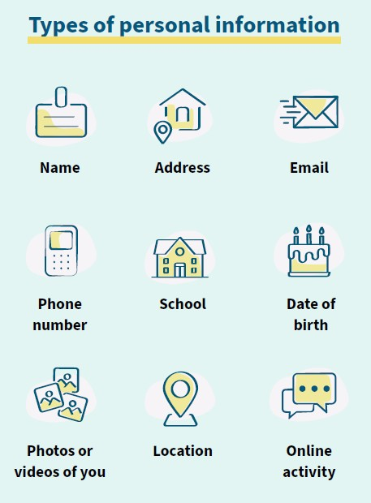
What is personal information?
Personal information is things like:
your name,
address, email,
phone number,
school,
date of birth,
photos or videos of you,
location,
online activity.
Protecting your personal information online is one important step to protecting your online privacy.

Slide 16
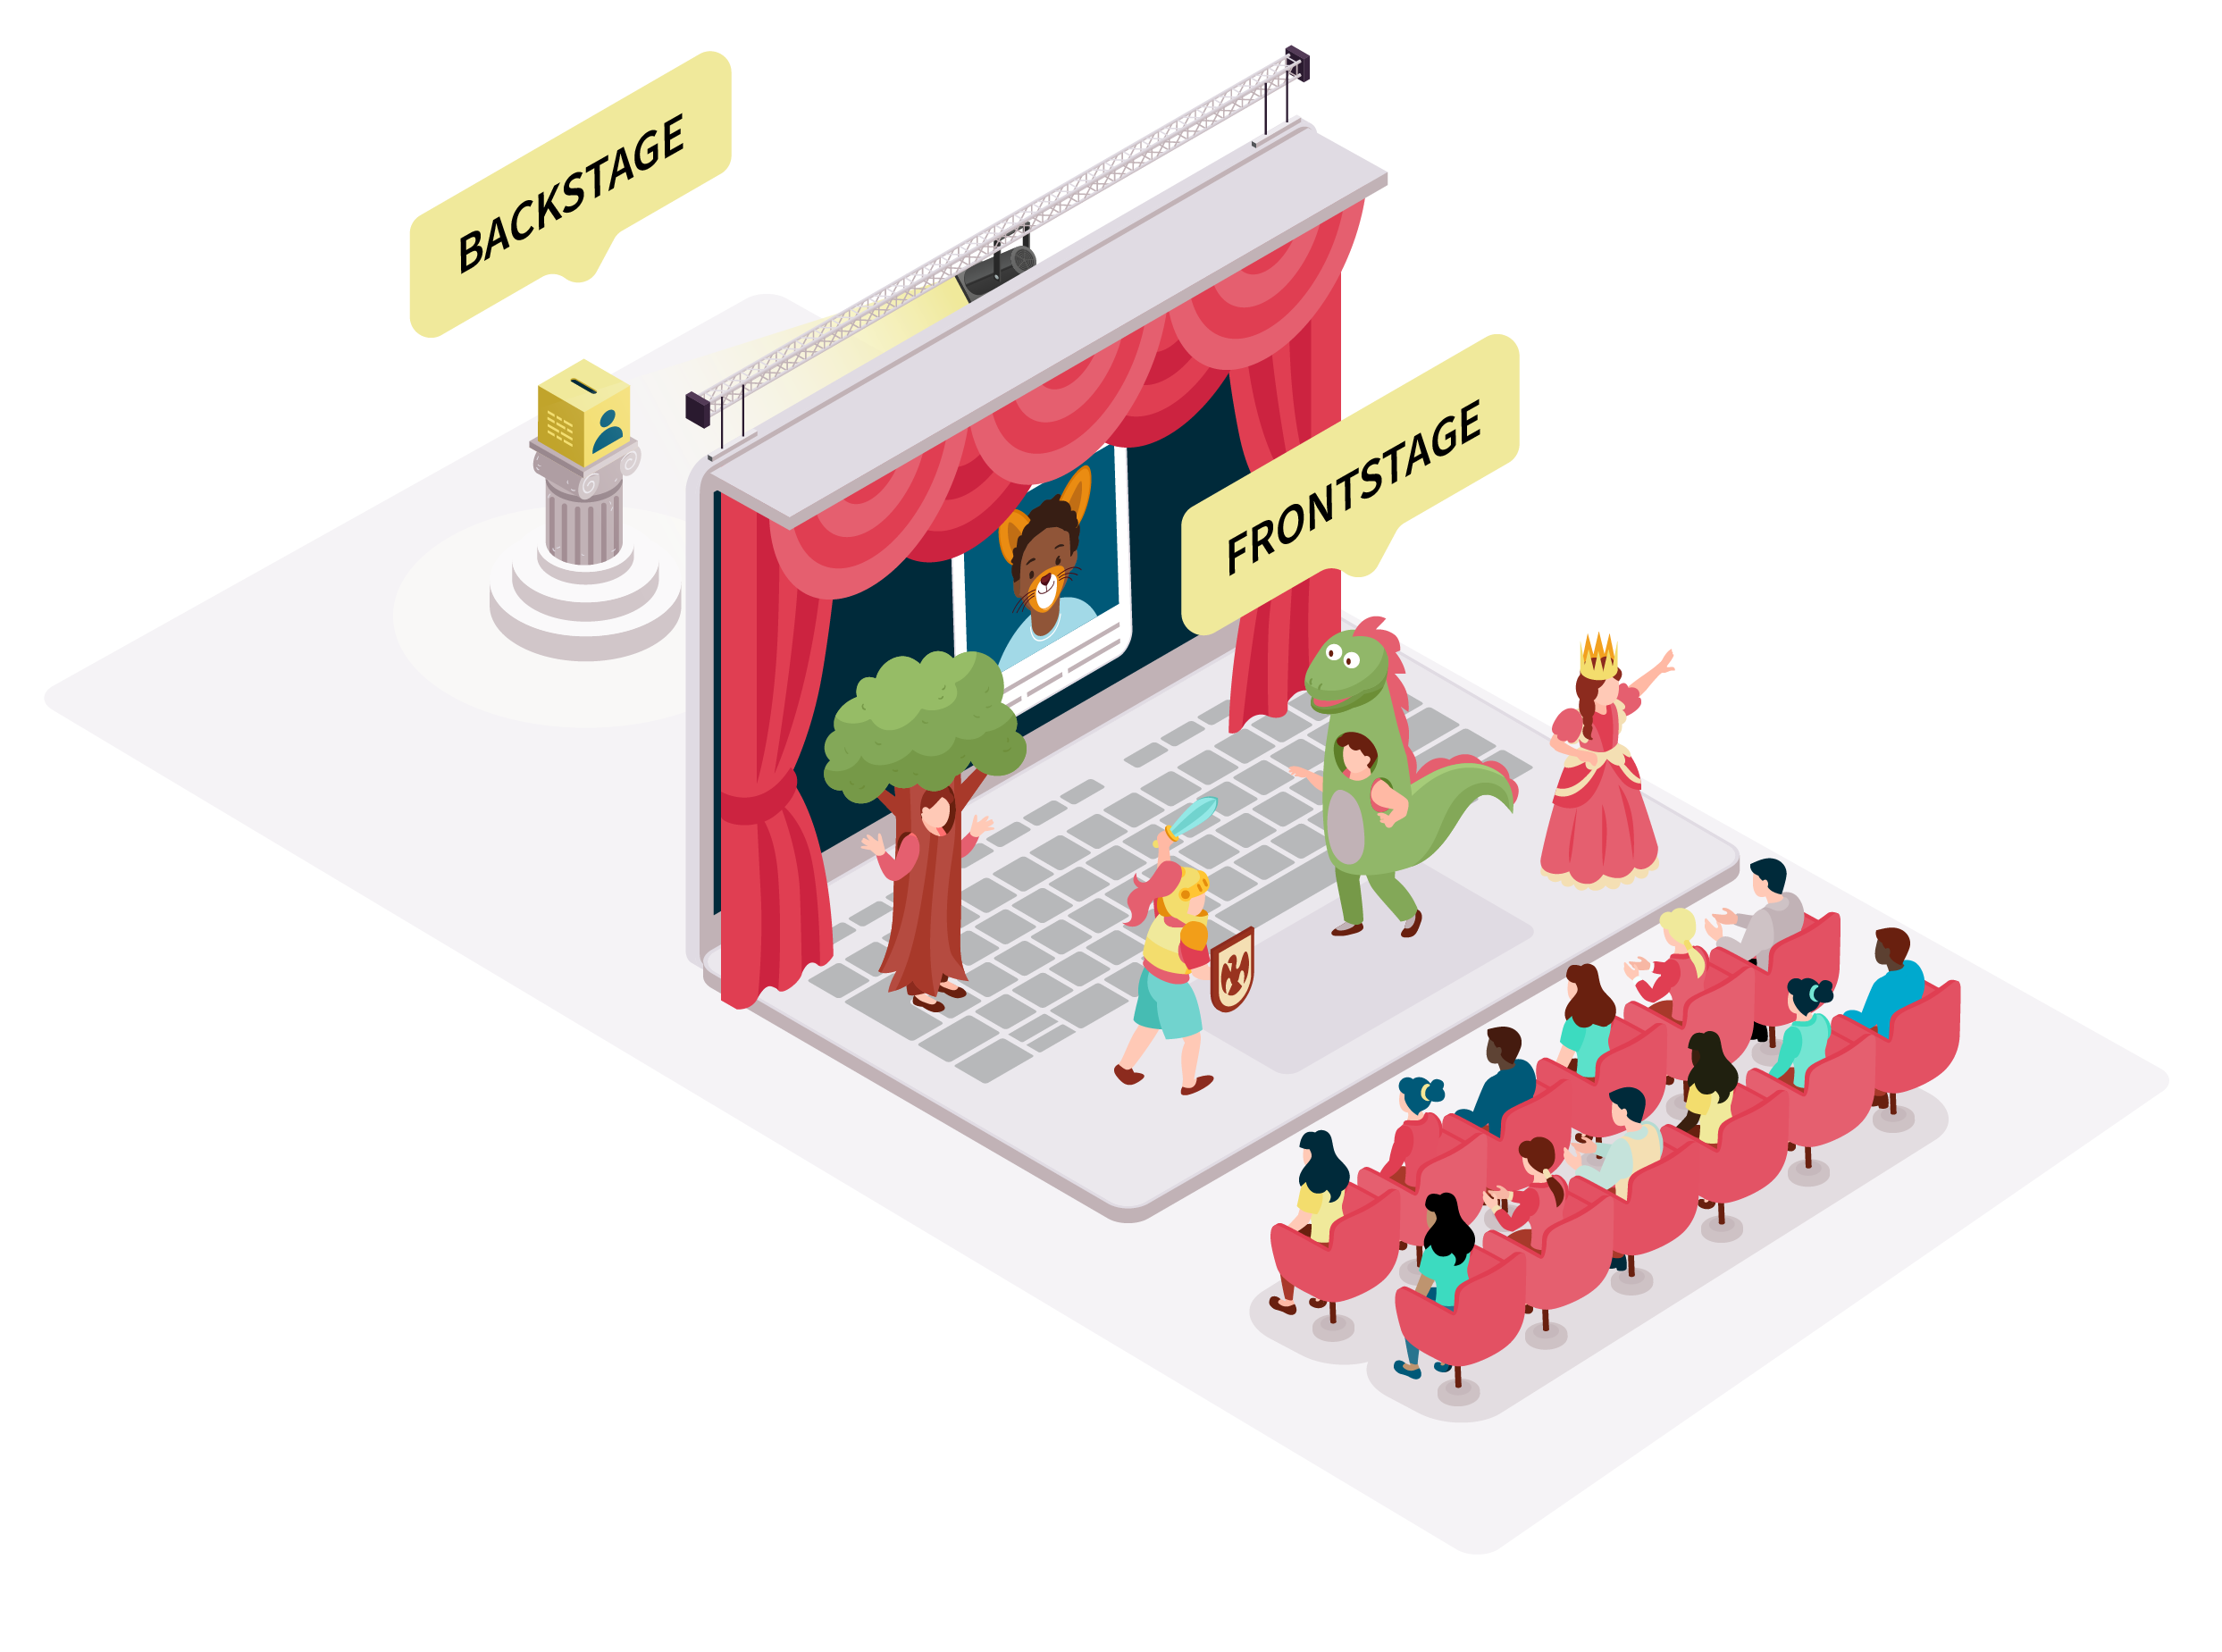
How does the Code protect online privacy?
Think about online privacy like a stage where you watch school assembly or a music concert, where the frontstage and backstage are separated by a curtain.
The frontstage is in front of the curtain and is where everyone in the audience can see what is happening. The frontstage is like where you or other people share things about you online for other people to see (like sharing photos of you with your friends and family).To help protect your online privacy frontstage, you and other people (like your family, friends, school and clubs) need to think carefully about what is shared publicly for others to see.
The backstage is behind the curtain and is where only the people running the show can see what is happening. The backstage is like where you share your personal information with an app, game, or website to use that online service. To help protect your online privacy backstage, online services need to take care of the personal information you choose to share with them.
The Code focuses on protecting your online privacy backstage. It does this by shining a light on what happens to children's personal information behind the curtain, telling online services how to take care of your personal information, and giving children more control with what happens to their personal information online.

Slide 17

Activity 2: Scenario-based activity for each rule of the Code

Slide 18
Rule 1: Many online services will need to follow the rules in the Code
These include online services:​
  that you use in your daily life, like messaging apps, games, and education websites, and​ education websites, and
  that the adults in your life use to record and share personal information about you, like school apps used by teachers to message your parents or apps that parents use to track their babies sleep.
Scenario 1​
You overhear your parent or carer talking about an app they used to use when you were younger called, ‘The Kid Diary’.​
​
You ask them what they are talking about and they tell you that when you were in pre-school, the educators would fill in the ‘diary’ on your pre-school days. Your parent or carer would read the diary entry at the end of the day.​
​
Your parent or carer tells you that the diary had lots of pictures of you playing, listening at story time, and videos of you dancing during dress-up time. The diary also included what and how much you ate, as well as how well you could count and whether you could write your own name.​
​
You have never seen this diary, and you didn’t even know that it existed.​
​
You ask yourself, “how is it possible that you didn’t know that your personal information was being collected, used and shared, when it is all about you!?”

Slide 19
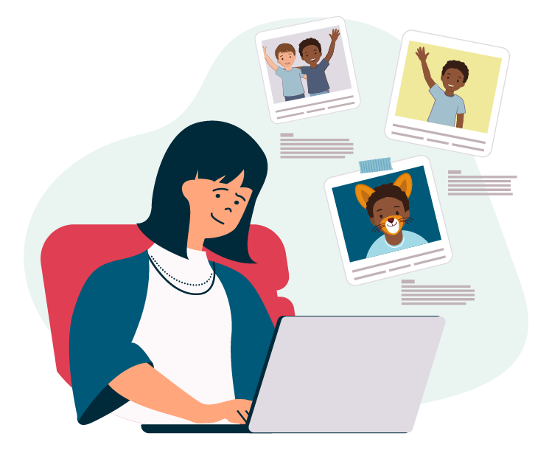
Rule 1: Many online services will need to follow the rules in the Code
Once the Code is in place, many online services that you use AND ones that you do not use but the adults in your life use to share your personal information (like this one!), will need to follow the rules in the Code.​
​
This means that even online services that aren’t made for you, or aren’t used by you, like ‘The Kid Diary’ app, will need to follow the rules in the Code.
Do you
1. Like 🙂,
2. Dislike ☹️, or
3. Neither 😐 like nor dislike
Rule 1?

Slide 20
Rule 2: To protect your personal information, online services have to either give everyone better privacy protections or check your age
If the online service is used by both children and adults, the online service can either give adults the same privacy protections as children or check your age. Checking your age will not stop you or limit your use of the online service but it will make sure that the online service is taking care of your personal information in the right way.
Scenario 2​
You are excited to play 'The King of Wizards' with your parent or carer, for the first time!​
You are going to try and beat their high score.​
The King of Wizards if played by both children and adults, but the game doesn't know who is a child and who is an adult.​
Right now, 'The King of Wizards' game takes care of both you and your parent or carer's personal information in the same way.​

Slide 21
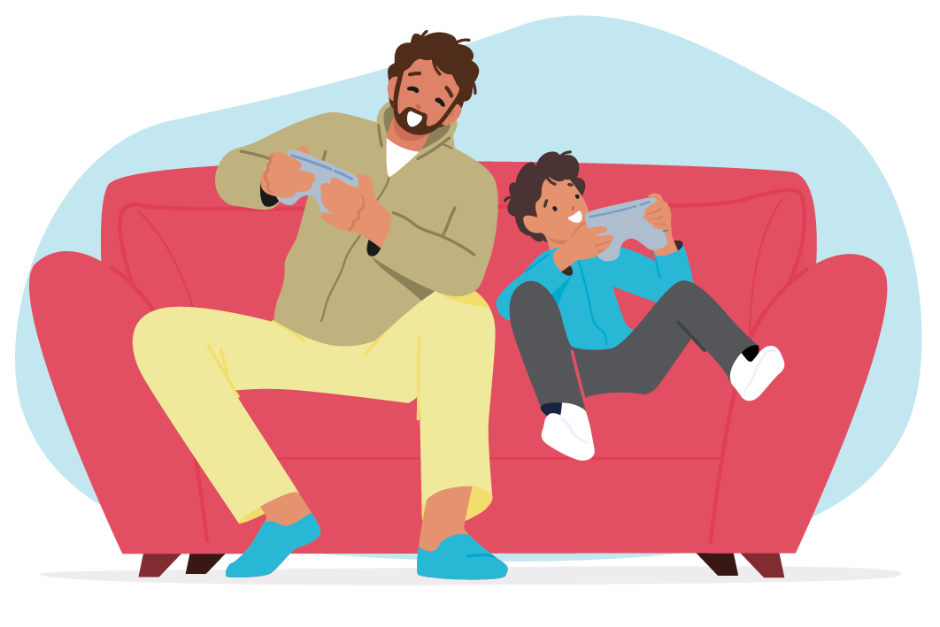
Rule 2: To protect your personal information, online services have to either give everyone better privacy protections or check your age
Once the Code is in place, online services need to make sure that these rules apply to children's personal information. ​
This means that online games like ‘The King of Wizards’ will need to make sure they have the right privacy protections in place.​ If the game is not going to apply the same protections to adults as they must for children, they might need to check your age before you ​play the game.​
Checking your age will not stop you or limit your use of games like ‘The King of Wizard’ but it will make sure that the game is taking care of your personal information in the right way.
Do you
1. Like 🙂,
2. Dislike ☹️, or
3. Neither 😐 like nor dislike
Rule 2?

Slide 22
Rule 3: Online services can only collect, use or share the bare minimum amount of your personal information they need to run the app, game or website unless you choose differently
Online services can do this by raising the standard when it comes to privacy protections and giving you (and your parent or carer) the control to change your privacy settings to share more personal information, if that is what you want
Scenario 3​
Think back to 'The King of Wizards' game (see Scenario 2).​
​
To start playing the game with your parent or carer, you sign up and crate an account with your name and your email address.​
​
Before you play the game, a message pops up. The game is now asking you for your date of birth, your phone number, your street address and what country you live in.​
​
Annoyingly, you try to close the message, but you can't seem to play the game without giving the game the personal information it is asking for.​
​
You feel a bit confused, why would game need all this information for you to play it?​
​
Mostly you are annoyed because you only get 1 hour of game time per day, and you have already wasted 15 minutes, so you quickly type the information in and press the ‘enter’ button. ​

Slide 23
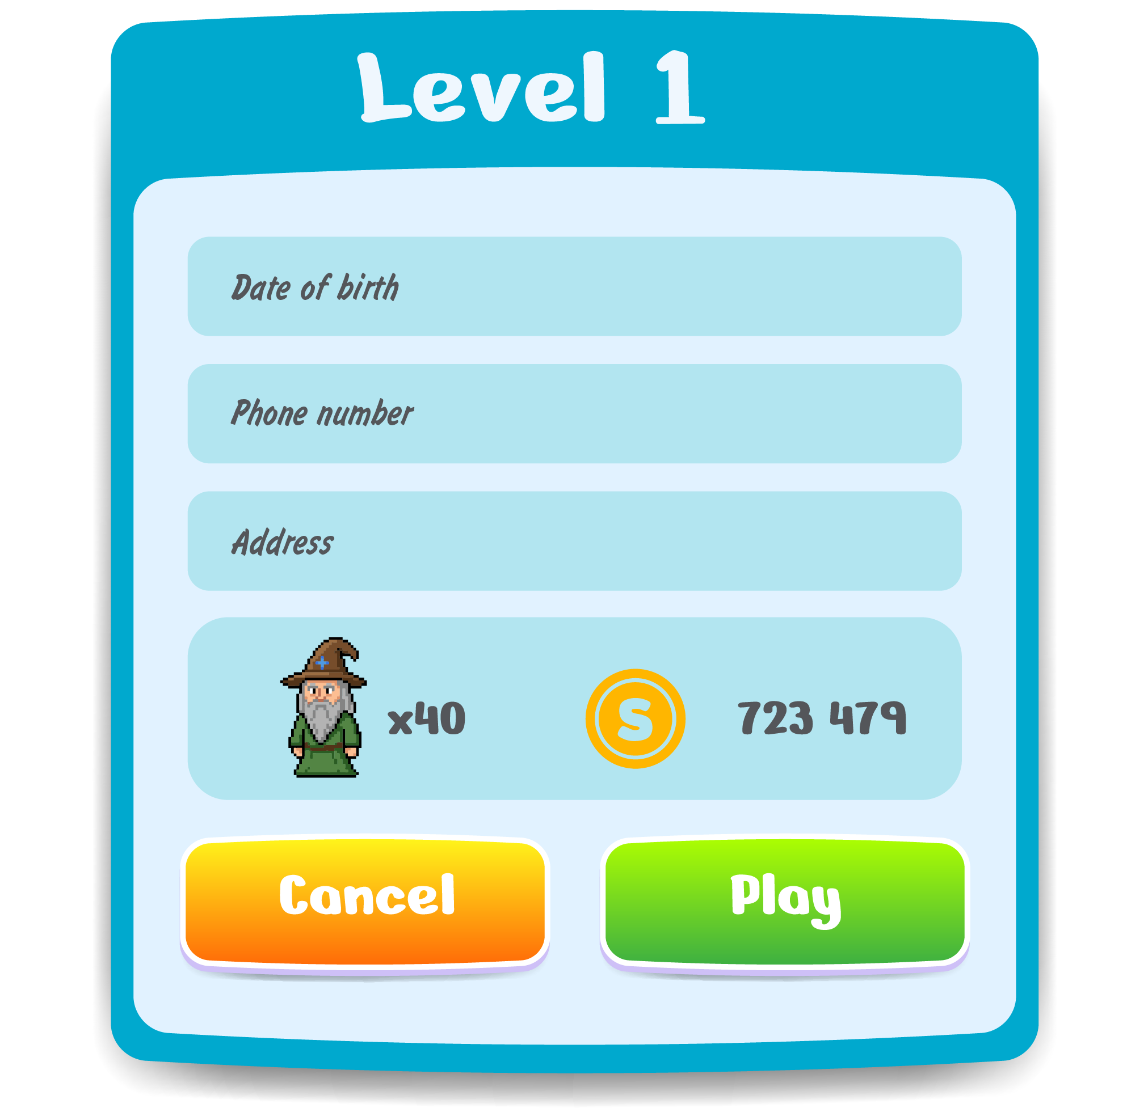
Rule 3: Online services can only collect, use or share the bare minimum amount of your personal information they need to run the app, game or website unless you choose differently
Once the Code is in place, online services will give you more control over your personal information by giving you (and your parent or carer) the choice to change your privacy settings to share extra personal information (more than the bare minimum to run an app, game or website), if that is what you want.​
​
This means that online games like ‘The King Wizard’ will need to raise the standard when it comes to their privacy protections and only collect, use or share the bare minimum amount of personal information they need to run the game, unless you (and your parent or carer) choose differently. ​
Do you
1. Like 🙂,
2. Dislike ☹️, or
3. Neither 😐 like nor dislike
Rule 3?

Slide 24
Rule 4: Online services need to be fair and take care of your personal information in a way that is best for you
When online services collect, use or share your personal information it must be in your best interests (meaning it is best for you and fair).
Scenario 4​
There is a cool online shopping game called ‘Shop With Me’, that everyone is talking about on the playground. The game lets you pretend to shop.​
​
You go home, you download the game and to play you must create a profile.​ To create a profile, you need: a username, a profile picture, to tell them your birthday, and your address.​ You quickly to do it, and you are all set to play. The game is so fun!​
What makes this game so fun, is that on the side of your tablet screen there are ads that tell you that you can buy the real-life version of things you are​ pretend buying in this game.​ The game has shared your personal information with companies to show you special ads that they know you will like and now you can click a button​ that says, ‘Buy me now’ and get things delivered to your house in two days.​
Your friends start to come to school telling you that they have bought so many of the real-life things that you can only have in your pretend wardrobe.​ You start to feel sad and left out. Seeing these special ads chosen for you, is making you feel bad. You just want them to go away.​

Slide 25
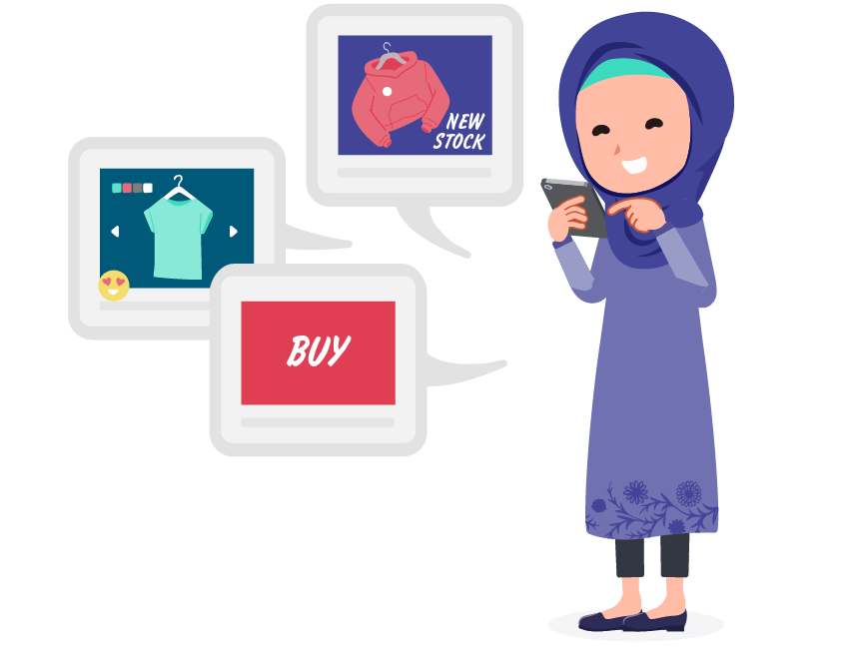
Rule 4: Online services need to be fair and take care of your personal information in a way that is best for you
Once the Code is in place, online services must stop and think about if what they do with your personal information (like show ads that are​ specially for you) is what is best for you. ​
​
This means that online games like ‘Shop With Me’ will need to ask themselves if it is fair to show you ads that have been specially picked just for you.​
​
If the answer is that it is unfair and not in your best interest, the online service must not use or share your personal information to figure out what ads​ they should be showing you to try to get you to buy something. ​
Do you
1. Like 🙂,
2. Dislike ☹️, or
3. Neither 😐 like nor dislike
Rule 4?

Slide 26
Rule 5: Online services need to ask for your permission to do things with your personal information
If you are 15-years-old or older, you can make your own decisions about your personal information online. Online services can go to you directly to ask for your permission.​
​
If you are under 15-years-old, your parent or carer will need to be asked for permission to make decisions about your personal information online.
Scenario 5​
Imagine yourself as a teenager who is 15-years-old in a private secondary school.​
At morning assembly, your principal says that the school has developed its own app called ‘School Homework’ that will let you connect with other ​students at your school to do homework together.​
​
You are told that the app needs some personal information (first and last name, date of birth, email address, school year and class name) to create an account and ​that this personal information will be shared with the school to make sure you go to that school and to connect you with the right students in your class.​
To begin using the app you need to hand over this personal information. Because you are 15-years-old, the app can go directly to you to ask for your permission to​ share that personal information.​

Slide 27

Rule 5: Online services need to ask for your permission to do things with your personal information
Once the Code is in place, if you are 15 years-old or older, online services no longer need to get permission from your parents or carers to collect, use, or​ share your personal information. They will now go straight to you, and you can give permission by saying either ‘yes’ or ‘no’.​
​
If you are under 15-years-old, online services will need to ask your parent or carer for permission to make a decision about your personal information​ online by either saying ‘yes’ or ‘no’.​
​
This means that online apps like ‘School Homework’ will ask for your permission directly, if you are 15-years-old and older, and if you are under 15-years-old, the app will need to​ ask permission from a parent or carer.​
​
Do you
1. Like 🙂,
2. Dislike ☹️, or
3. Neither 😐 like nor dislike
Rule 5?

Slide 28
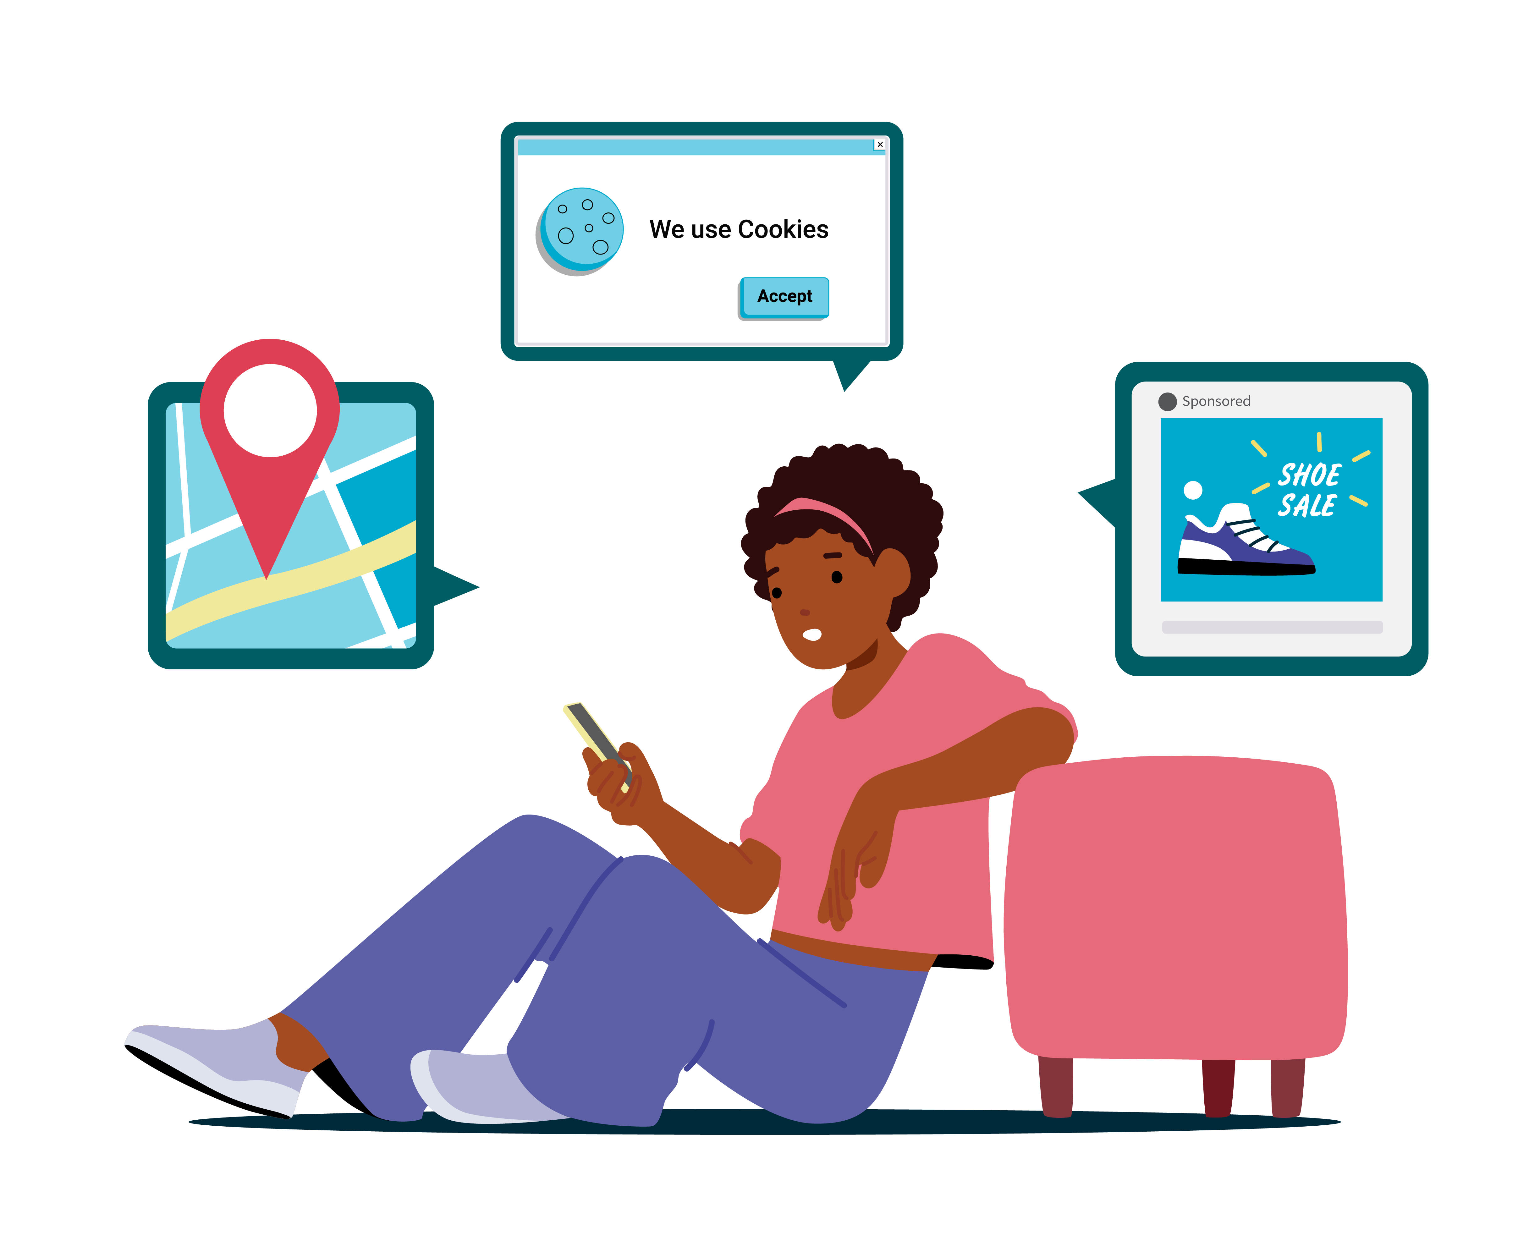
Rule 5: Online services need to ask for your permission to do things with your personal information
If you think that Rule 5 should have a different age, what age do you think children should be allowed to give permission without their parents or carer's permission?​
12
13
14
15
16
17
18+

Slide 29
Rule 6: If you are under 15-years, in some situations online services will need to involve both you and your parent, to get permission to change your privacy protections
If you choose to allow an online service to:​
  use or share your personal information for some reason beyond the bare minimum to run the app, game, or website (like to show you ads that have been specially picked, just for you), or​
  collect sensitive information (which is personal information that needs to be treated extra carefully, like your health information).
The online service will ask you first to give permission to share your personal information so that you get to have a say (part of getting that permission​ means that the online service must give you an explanation of what the change means so that you understand what will happen and why).​
The online service will then ask your parent or carer if they give permission, either ‘yes’ or ‘no’, because they have ultimate say. Only once your parent or​ carer has said ‘yes’ can permission be granted and the change to your privacy protections happen.
Scenario 6​
Think back to the scenario with the ‘School Homework’ app (see Scenario 5), but you are back to your actual age (under 15-years-old).​
This app is being used at your primary school. Your friends tell you that there is a setting within the ‘School Homework’ app that you can change and​ this change means that your personal information will be shared with all the homework tutors in your suburb.​ Your friend tells you that he has been able to get so much help from the tutor in his suburb, and his maths is improving because of it!​
​
You are excited, so you find the setting on the app and change it straight away.

Slide 30

Rule 6: If you are under 15-years, in some situations online services will need to involve both you and your parent, to get permission to change your privacy protections
Once the Code is in place, online services will need to tell you what making a change will do, it will then ask you if it’s okay to email your parent or carer (or let them know some other way) to tell them that you have asked for a change in your privacy​ settings. It is then up to your parent or carer to give the final ultimate permission by saying either ‘yes’ or ‘no’, for that change to happen.​
This means online apps like ‘School Homework’ will need to ask permission in a way that involves both you and your parent or carer, if the app wants to use​ or share your personal information in a specific way.
Do you
1. Like 🙂,
2. Dislike ☹️, or
3. Neither 😐 like nor dislike
Rule 6?

Slide 31
Rule 7: Online services must not trick you into giving them permission
Online services must not deliberately trick, confuse, or pressure you into giving permission to collect, use, or share your personal information. This means online services cannot do things like be sneaky and hide buttons that give you a choice to say 'no'.
Scenario 7​
Imagine everyone on your soccer team uses this website called ‘Soccer Friend’ that shows your soccer games, the results of weekly games, and who is coming first. ​
​
You are checking out where your team sits on the leaderboard, and a message box pops up that says:​
​
“90% of your friends have shared their contact list and allowed access to their photos.​
Allow access and unlock player profiles to see which player is ranked number 1!”​
​
You don’t really want the game to be able to see your photo gallery and your contact list because it sounds sort of creepy, but you really want to see who the number 1 ranked player is.​
​
You also think, “if most of my friends have said yes, surely it can’t be that bad?”​
​
So, you quickly click the big green button that says, ‘I give permission’, missing the smaller grey button that says, ‘I am happy without the special extras’.​

Slide 32

Rule 7: Online services must not trick you into giving them permission
Once the Code is in place, online services will not be allowed to trick you and take advantage of your fear of missing out, to pressure you to say ‘yes’ and hand over your personal information that you do not want or need to share.​
​
This means that websites like ‘Soccer Friend’ will not be allowed to trick, confuse, or pressure you into giving them permission to collect your personal information.
Do you
1. Like 🙂,
2. Dislike ☹️, or
3. Neither 😐 like nor dislike
Rule 7?

Slide 33
Rule 8: Online services must make sure that the permission they get from you (or your parent or carer) is 'good' permission
When online services ask for your permission to collect, use or share your personal information online, they need to tick the 6 boxes below for that permission to be 'good' permission:​
  without pressuring, tricking or confusing you into making a decision (voluntary),​
  give you all the right information you need to make a decision (informed), ​
  ask you often and at the right times because permission does not last forever (current), ​
  make sure that you know that you are allowed to take back your permission at any point (be withdrawn), ​
  make sure that you understand ‘why’ they need your personal information and ‘what for’ (specific),
  make sure that you have clearly agreed and given your permission with a solid ‘yes’, because when you say ‘maybe’ or nothing at all, itis a ‘no’ (unambiguous).

Slide 34
Rule 8: Online services must make sure that the permission they get from you (or your parent or carer) is 'good' permission
Scenario 8​
Think back to the previous ‘Soccer Friend’ website (see Scenario 7) with the message box pop up that says:​
​
“90% of your friends have shared their contact list and allowed access to their photos. Allow access and unlock player profiles to see which player is ranked number 1!”​
In this scenario, the online service:​
has put pressure on you by telling you that “90% of your friends have given permission”. This means your permission has not been given voluntarily.​
has not told you what will happen if you do and don’t give them access. This means you have not given informed permission.​
cannot just ask you once for permission because imagine if you use that website for 5 years, your permission cannot last for 5 years (you change a lot over 5 years!). This means that the permission is not current.​
did not tell you that if you give them permission this time, you can take the permission back at any time. This means permission cannot be withdrawn.​
did not tell you why they want to access your contact list and photos and did not tell you exactly what giving them permission would mean for your contact list and photos. This means you have not given specific permission.​
did not make it clear that there was a “permission granted” as well as a “permission denied” option. This means the permission was ambiguous or not very clear or obvious.

Slide 35

Rule 8: Online services must make sure that the permission they get from you (or your parent or carer) is 'good' permission
Once the Code is in place, online services must make sure that when they ask permission, the 6 boxes below are ticked:​
  without pressuring, tricking or confusing you into making a decision (voluntary)​,
  give you all the right information you need to make a decision (informed), ​
  ask you often and at the right times because permission does not last forever (current), ​
  make sure that you know that you are allowed to take back your permission at any point (be withdrawn), ​
  make sure that you understand ‘why’ they need your personal information and ‘what for’ (specific),​
  make sure that you have clearly agreed and given your permission with a solid ‘yes’, because when you say ‘maybe’ or nothing at all, it is a ‘no’ (unambiguous).
This means that when websites like ‘Soccer Friend’ do not tick the 6 boxes, they did not do the right things to get ‘good’ permission from you.​
Do you
1. Like 🙂,
2. Dislike ☹️, or
3. Neither 😐 like nor dislike
Rule 8?

Slide 36
Rule 9: Online services must make sure you can access and understand what they do with your personal information
Online services must make sure that their privacy policies and any notices that 'pop up' that tell you what they do with your personal information, is child-friendly. That means they need to be easy to read and understood by you (no big words!) .
​
Online services must make it easy for you to find the instructions on the app, game or website that tell you how to ask for what personal information the online service knows about you.​
Online services must make it easy for you and your parent or carer to ask for what personal information is known about you and what the app, game or website does with it.​
Online services must make it easy for you to ask them to stop showing you ads that have been specially picked, just for you and the main goal of the ads are to get you to buy things.
Scenario 9​
Think back to ‘The Kid Diary’ scenario (see Scenario 1)​. You keep wondering about all that personal information that your educator shared with the app all those years ago for your parent or carer​ to see.​
You want to ask ‘The Kid Diary’: do they still have the diary entries? who can see the diary entries? did they share the diary entries with​ anyone other than your parent or carer and the pre-school? If they did, who did they share it with, and why?​
You and your parent or carer visit the website for ‘The Kid Diary’ app to find out more information. But there are so many buttons that lead to more buttons. It is very confusing to find the information.​ When you do eventually find the right information, you find that the words are big and long, and nothing makes much sense.
You go to bed so frustrated. You think, “It should not be this hard! Why isn’t there a button that just says: ‘Get help now’?”.​
​

Slide 37

Rule 9: Online services must make sure you can access and understand what they do with your personal information
Once the Code is in place, online services must tell you the important things about your online privacy in a way that is easy to find and​ easy to and easy to understand. Online services must also make it easy for you and your parent or carer to ask to see what personal​ information an online service has about you.​
​
This means that online apps like ‘The Kid Diary’ will need to design their app so that it is easy for you to find information on how to get help​ and write their privacy documents in a way that you can easily read and understand.​ This will help you and your parent or carer understand how to ask an online service what personal information they have about you​
​
Do you
1. Like 🙂,
2. Dislike ☹️, or
3. Neither 😐 like nor dislike
Rule 9?

Slide 38
Rule 10: Online services must answer you within 30 days (in most cases) if you ask to see, change or delete your personal information
Online services must respond to you (or your parent or carer) within a fair amount of time, if you ask to see, change or delete what personal information they know about you. If it takes longer than 30 days, the online services must explain to you why it is going to take longer.
Scenario 10​
​Keep thinking back to the last ‘The Kid Diary’ scenario (see Scenario 9)​
​
Hooray! Your parent or carer has now asked ‘The Kid Diary’ all the questions that you want answers to.​
​
(Reminder, these are: do they still have the diary entries? who can see the diary entries? did they share the diary entries with anyone other than my parents and the pre-school? If they did, who did they share it with, and why?)​
​
It’s been three months since your parent or carer asked the questions and you have not heard anything from the online service (not a peep!).​
​
You start to worry that you will never get the answers to your questions.

Slide 39

Rule 10: Online services must answer you within 30 days (in most cases) if you ask to see, change or delete your personal information
Once the Code is in place, online services must answer you within 30 days. If it is going to take a bit longer because there is lots of information for them to go through, that’s allowed, but there must be a good reason for it and they must explain that reason to you.​
​
This means that online apps like ‘The Kid Diary’ will need to answer your questions within 30 days, and if they look at your questions and decide that it is going to take longer than that, they must let you know and explain the reasons why it is going to take a longer time.
Do you
1. Like 🙂,
2. Dislike ☹️, or
3. Neither 😐 like nor dislike
Rule 10?

Slide 40
Rule 11: Online services must delete your personal information if you (or your parent or carer) ask for it to be permanently deleted
You can now ask an online service to permanently delete the personal information they have collected about you, and they have to do it unless there is a good reason they cannot (like a law says that they can’t).
Scenario 11​
​Keep thinking back to the last ‘The Kid Diary’ scenario (see Scenario 10)​.
​
Ugh, you are cringing! What happens if another parent or carer at school can see these diary entries, and they tell their child, and then that child tells everyone at school? What if they print the pictures and give them to people at school!?​
​
You start feeling nervous and annoyed, it feels like you have no control over what others can see about you.​
​
You really wish that you could just ask ‘The Kid Diary’, if they could permanently delete all the diary entries that are about you, so no one could ever see them again.

Slide 41
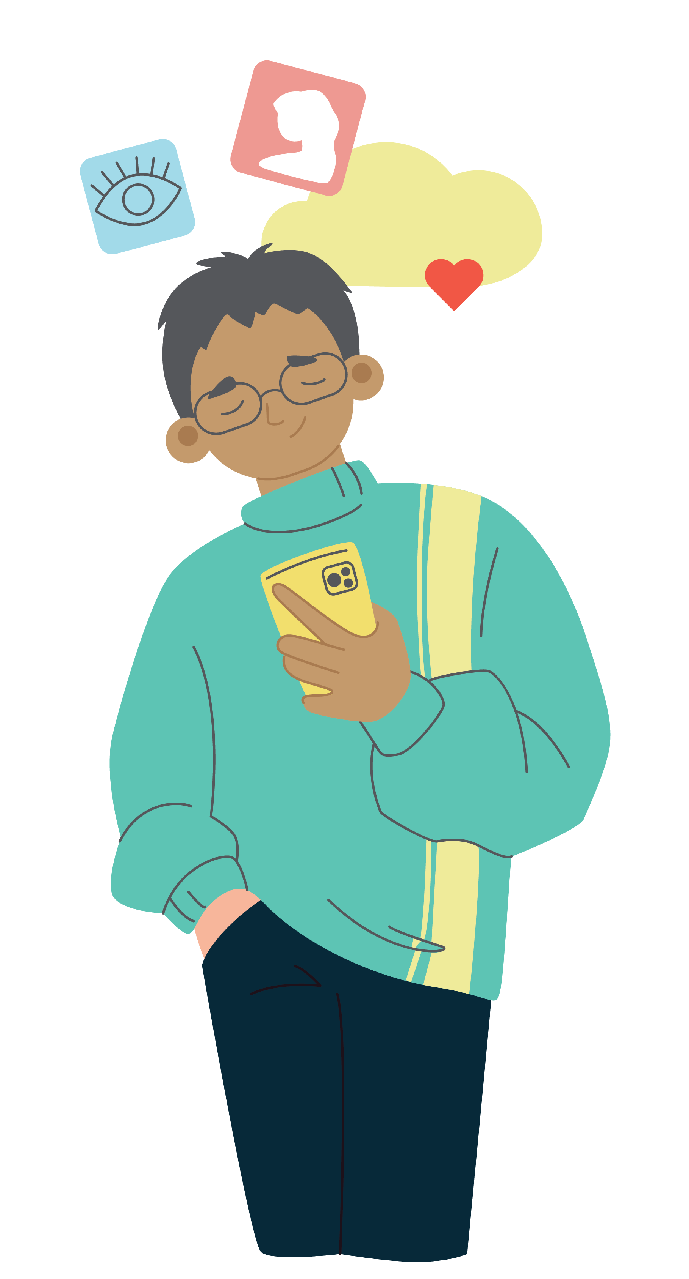
Rule 11: Online services must delete your personal information if you (or your parent or carer) ask for it to be permanently deleted
Once the Code is in place, you will be able to go directly to online services and ask them to permanently delete all records of your personal information.​ If the online service does not have a good reason to say no (like a law stops them), they have to say ‘yes’ and delete your personal information forever from their records.​
​
This means online apps like ‘The Kid Diary’ will need to delete your personal information if you or your parent or carer asks (unless there is a law that stops them).​ Once your personal information has been deleted forever from ‘The Kid Diary’ records, they need to tell you it has been done.​
​
Do you
1. Like 🙂,
2. Dislike ☹️, or
3. Neither 😐 like nor dislike
Rule 11?

Slide 42
Rule 12: Online services must tell you when your physical location can be seen by other people and parental controls are being used
Online services must tell you if your parent or carer can see your physical location or can see or control the activity that you are doing when using an app, game or website. Online services must also tell you if and when another user of the same online service can see where your physical location is by tracking your device (like your phone, tablet or smart watch).
Scenario 12.1​
​Your friend tells you a story at school about something that happened on a messaging app called ‘Chat Circle’ on the weekend, when she was away from home at a sleepover.​
​
'Chat Circle’ allows parents and carers to see who is messaging you and what is in those messages. Your friend got a message from an unknown number on her messaging app and responded, “how do I know you?”.​
​
Your friend tells you that when she got home, her mum had seen the messages, and they had a talk about how to be safe online and what to do when she gets messages from an unknown number.​ Your friend found the talk helpful but cannot figure out how her mum found out and saw the messages from the unknown number.​
​
Now you are curious because you also use ‘Chat Circle’, can your parent or carer also see who is messaging you and what is in those messages?

Slide 43
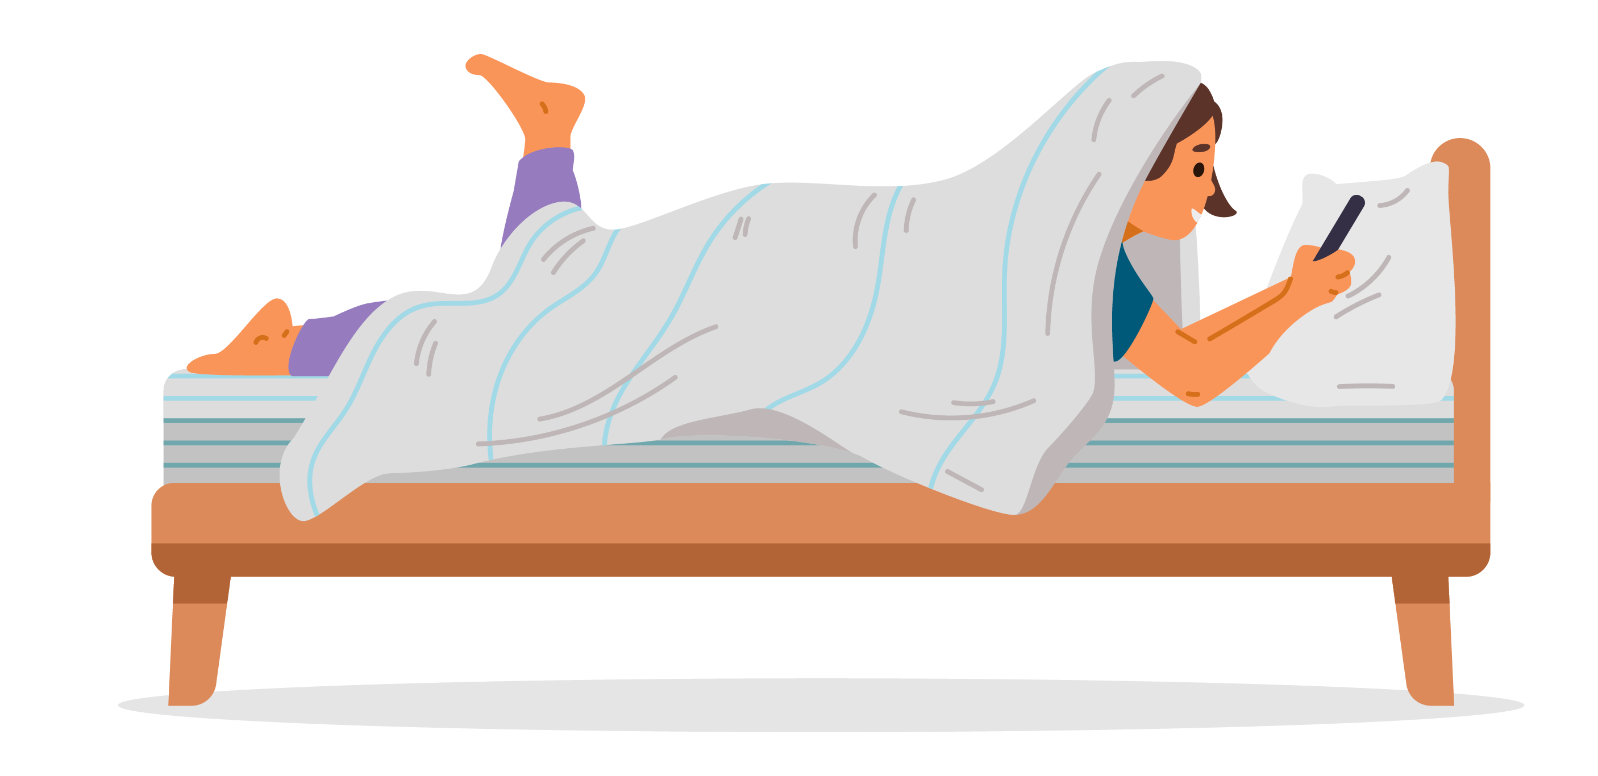
Rule 12: Online services must tell you when your physical location can be seen by other people and parental controls are being used
Once the Code is in place, online services must tell you if your parent or carer can see your online activity (including your physical location) while you are using the app, game or website.​
​
This means online services, like the ‘Chat Circle’ messaging app, will need to make it known to you that your parent or carer can see your online activity (including your physical location) when you are using the service.​​
Do you
1. Like 🙂,
2. Dislike ☹️, or
3. Neither 😐 like nor dislike
this part (Scenario 12.1)of Rule 12?

Slide 44
Rule 12: Online services must tell you when your physical location can be seen by other people and parental controls are being used
Scenario 12.2​
It is afternoon tea time at out-of-school care and you take a seat on the bench. Your friend asks you: “why did you say that you couldn’t come over to my place on the weekend? I know that you were at the movies!”​
You are shocked and you don’t know what to say, how did your friend know that you were at the movies? ​
You ask her, and she tells you it is because she saw it on ‘Chat Circle’, an online messaging app that you and your friends use every day to talk.
​You ask your other friend if that is true and she shows you that she can also see where you are by looking at the app.
This does not feel right and a little creepy, like you are being spied on!
​

Slide 45
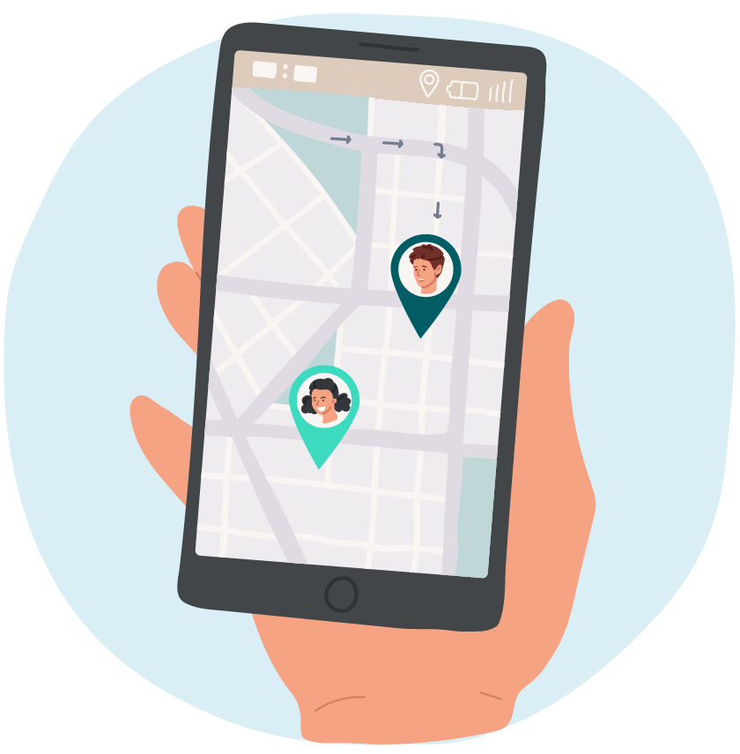
Rule 12: Online services must tell you when your physical location can be seen by other people and parental controls are being used
Once the Code is in place, online services must tell you if another user of the online service can see your physical location, by tracking your device (like a phone, tablet or smart watch). Online service must tell you as soon as the location tracking starts and when the tracking is happening.​
​
This means that online messaging apps like ‘Chat Circle’ will need to make it known to you if and when any other user of the same service can see your physical location.​
Do you
1. Like 🙂,
2. Dislike ☹️, or
3. Neither 😐 like nor dislike
this part (Scenario 12.2) Rule 12?

Slide 46
Rule 13: Online services must make it easy for you to ask questions and complain if there is a problem with your personal information
Online services must give you all the information you need in a way that you can understand, so that if you have questions or something goes wrong in how they have collected, used, or shared your personal information, you feel like you can easily ask a question or tell the online service that there is a problem (this is called, ‘making a complaint’).​
Scenario 13​
​Think back to the last ‘Chat Circle’ scenario (see Scenario 12.2).​
​
You know that everyone on your friend list can see where you are but can everyone in the entire world who is also using ‘Chat Circle’ see your physical location!?​
​
You try to find the answer on the app, but no luck. You cannot find information about what personal information of yours that ‘Chat Circle’ is sharing with others.​
​
You ask your parent or carer to help you look on the app’s website but there is no ‘Ask a Question’ or ‘Get Help’ section on the website. There is a phone number, but when you call it, it does not ring. ​
​
You feel frustrated. Why is it so hard to speak to someone, when something has gone wrong and you need help!?​
​

Slide 47

Rule 13: Online services must make it easy for you to ask questions and complaint if there is a problem with your personal information
Once the Code is in place, online services must make it easy for you to ask questions so that if something goes wrong in how they have collected, used, or shared your personal information, you feel like you can easily tell the online service that there is a problem (this is called, ‘making a complaint’).​
​
This means that online apps like ‘Chat Circle’ will need to make it easy for you to ask questions and get the help you need.​
Do you
1. Like 🙂,
2. Dislike ☹️, or
3. Neither 😐 like nor dislike
Rule 13?

Slide 48
Rule 14: Online services will need to think and plan before they act
Online services will need to plan (stop, think, write and record) how they will protect children’s online privacy, if they are creating a new service or changing their existing service. The Code will also make sure that the people who work for online services, who look at your personal information often, are trained to protect children’s online privacy.
Scenario 14​
​Think back to the soccer website scenario (see Scenario 7).​ The soccer website ‘Soccer Friend’ wants to create a new and improved version of that website.​
​
The website is going to collect a lot more personal information about children because they are going to add new functions like ads for fancy soccer boots, special profiles for soccer players, and the ability to chat online.​
​
The owner of the website is told by one of his workers that she thinks that the website might need to think more carefully about the impacts these new functions of the website will have on children’s online privacy.​ But the owner of the website has heard a rumour that someone is going to start a similar website at the end of the year. So he wants to hurry up and make the new website first.​
​
Work on the new website starts immediately without thinking about how these new functions will impact children’s online privacy.​
​

Slide 49

Rule 14: Online services will need to think and plan before they act
Once the Code is in place, online services will need to plan (stop, think, write and record) how they will protect children’s online privacy before they add extra functions to their app, game or website.​
​
Online services will also need to make their plan available for others to see (like the OAIC) and make sure that the people who work for the online service who look at your personal information often, are trained to protect children's online privacy.​
​
This means that websites like this 'Soccer Friend’ won’t be able to rush into anything new or change the way they collect children’s personal information, without planning how they will protect children’s online privacy before they add extra functions to the app, game or website.​
Do you
1. Like 🙂,
2. Dislike ☹️, or
3. Neither 😐 like nor dislike
Rule 14?

Slide 50

Discuss as a group,
what do you feel most excited about the Code?
are there any rules missing?

Slide 51
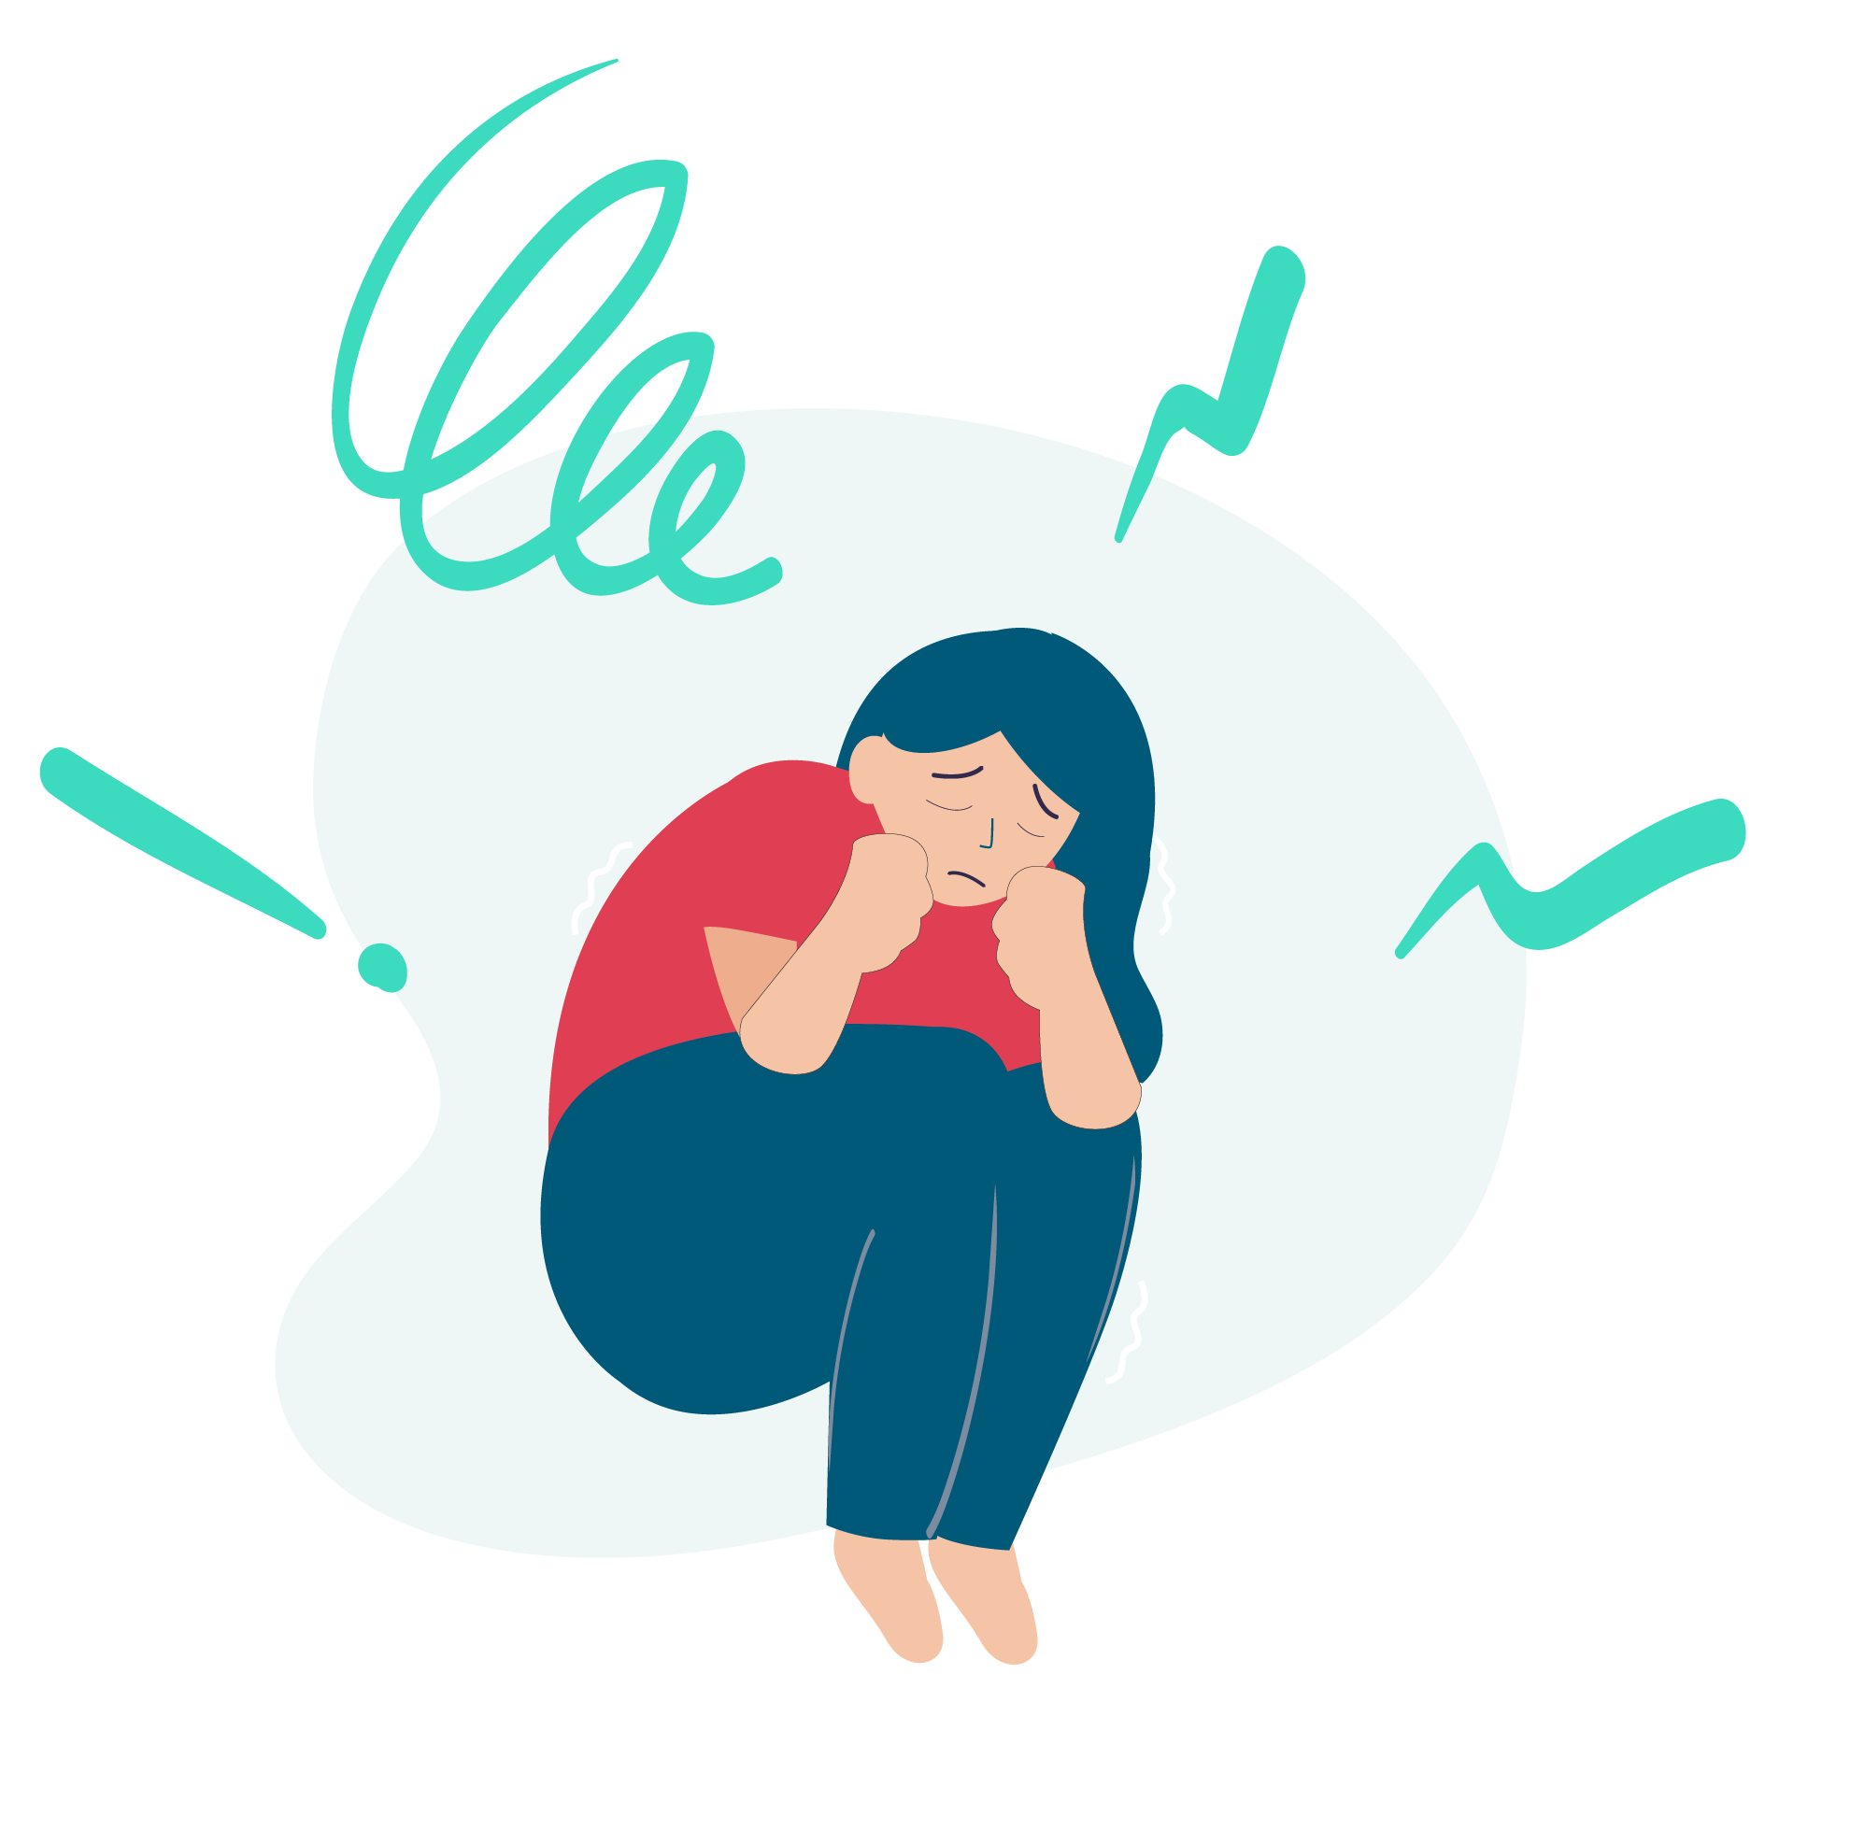


Remember, whilst the Code will help protect your personal information online, it’s still important for you to be careful when online.
Always talk to a trusted person if something doesn’t feel right of if you are feeling unsure about an online experience you have had.
  If you want to speak to someone about anything you read here, you can call Kids Helpline Counselling Service | 1800 55 1800, it is free and confidential, meaning that they won’t know who you are.

Slide 52
Thankyou
Learn more by heading to:
https://www.oaic.gov.au/privacyforkids
For specific questions or concerns, please email the OAIC at copc@oaic.gov.au

