Slide 1
Privacy and Registered Training Organisations
Lessons from an OAIC privacy assessment

Slide 2
In today’s webinar:
About the OAIC and our privacy assessments
The RTO survey assessment
Positive findings
Areas for improvement
Navitas – lessons learned
Tips for good privacy practice
Q and A

Slide 3
About the OAIC

Slide 4
About the OAIC
Privacy, freedom of information, information policy
Far-reaching jurisdiction and diverse stakeholders
A variety of regulatory functions and powers to promote privacy and enforce the Australian Privacy Principles (APPs)
oaic.gov.au
1300 363 992

Slide 5
The legal framework
RTOs are regulated by overlapping laws and regulations
Privacy Act 1988 (Cth)
Various state and territory privacy laws apply to state and territory government agencies
Student Identifiers Act 2014 (Cth)

Slide 6
Privacy assessments (audits)
A proactive measure
Public and private sectors
Flexible methodologies depending on the objective and scope
oaic.gov.au/privacy-law/assessments/

Slide 7
The RTO survey assessment

Slide 8
Scope
APP 1
open and transparent management of personal information
APP privacy policy
APP 5
notification of the collection of personal information

Slide 9
Methodology
Agreed between the OAIC and the USI Office
Selected five RTOs based on certain criteria
Conducted via a self-administered smart form survey in November 2017

Slide 10
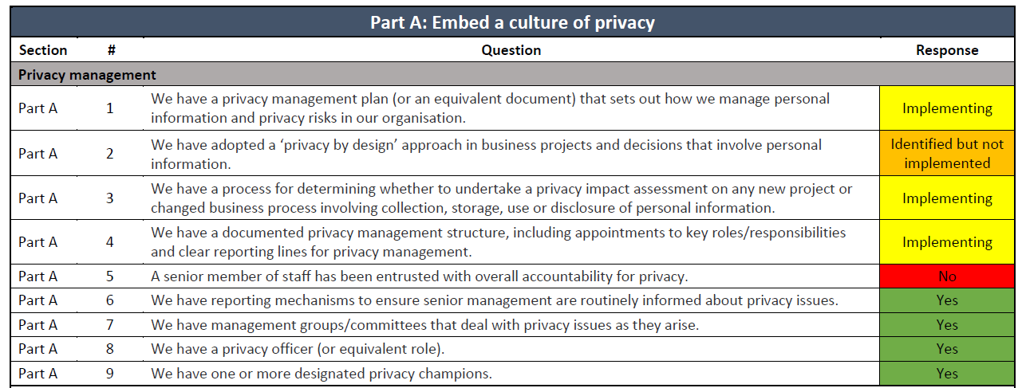

Slide 11
Navitas - participating in the privacy assessment

Slide 12
Navitas Limited – the Audit landscape
The audit process involved Navitas English Pty Ltd, a member of the Navitas Limited Group
Increased data security and privacy regulation
The audit coincided with Navitas Limited’s review of:
Global policies and procedures
Information security environment and IT architecture
Managing information, personal and commercial

Slide 13
Navitas Limited – the Audit process
The OAIC is a key resource
Protecting privacy and data sovereignty is a global phenomenon
Getting to know another Regulatory Authority
Objective, external perspective on our privacy management systems, processes and policies
Breadth and depth of privacy management – holistic governance approach needed
Embedding the Privacy Principles as standard ‘good practice’ is essential

Slide 14
Navitas Limited – key imperatives
Enhance awareness and understanding of privacy principles
Operationalise privacy principles – everyone is responsible for protecting privacy
Embed ‘privacy by design’ into Company culture
Standardise and regularise training for all staff
Implement awareness of and need for Privacy Impact Assessment (PIA)
Train staff – administrative and academic

Slide 15
Assessment results

Slide 16
Positive findings
Clear processes for collecting and disclosing personal information
Processes to ensure data quality
Enabling students to access and correct their personal information
Effective complaint handling mechanisms

Slide 17
Areas for improvement
Privacy practices that move from operations up to the governance level
Privacy training for new and existing staff
Having privacy policies and collection notices available in alternative languages and formats

Slide 18
Areas for improvement
Data breach response
Information security
Policy reviews
Access monitoring

Slide 19
Navitas – Lessons learned

Slide 20
Navitas Limited – What did the Audit change?
Privacy fundamental to Company culture
Global commitment to Privacy by Design (PxD) across all operational activity
Privacy management and acceptance of APPs built into terms and conditions of employment
Implementing the GDPR across all operating regions
Privacy Management is not a ‘silo’ activity - it’s a global responsibility
Getting it wrong is a costly business!

Slide 21
Navitas Limited – What’s happening now?
Developed and implemented Data Subject Access Request (DSAR) Procedure
Established, implemented and tested Data Breach Management procedure – triage approach
Implemented global privacy management platform
Implemented compulsory staff training - managing personal information; reporting suspected breaches
Privacy framework, policy and procedure revitalised in line with APPs and GDPR requirements

Slide 22
Navitas Limited – What’s happening now?
Established global network of Data Protection Managers (DPM’s) in each operating region and global community of practice (CoP)
PxD workshops developed and being implemented
Privacy Notice translated into seven languages with more to come
Revised approach to consent; complaints; accessing personal information
PIA and DPIA embedded into Project and new initiatives design and development

Slide 23
Tips for good privacy practice

Slide 24
Privacy governance
Appoint a ‘privacy champion’ amongst your senior leadership group
Privacy management plans (PMPs) are a good way to document your approach to privacy governance
PIAs can feed into PMPs
Privacy Management Framework on our website

Slide 25
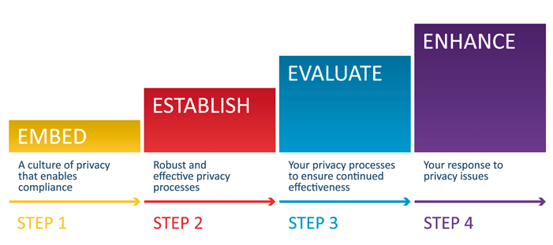
Privacy governance

Slide 26
Privacy training
For all staff: full time, part time, temporary and contractors
Upon commencement and refreshed as necessary
Reduce the potential for human error
https://www.oaic.gov.au/agencies-and-organisations/training-resources/

Slide 27
Data breach response
NDB scheme effective since 22 February 2018
New notification obligations
OAIC resources for agencies and organisations available online
https://www.oaic.gov.au/privacy-law/privacy-act/notifiable-data-breaches-scheme

Slide 28
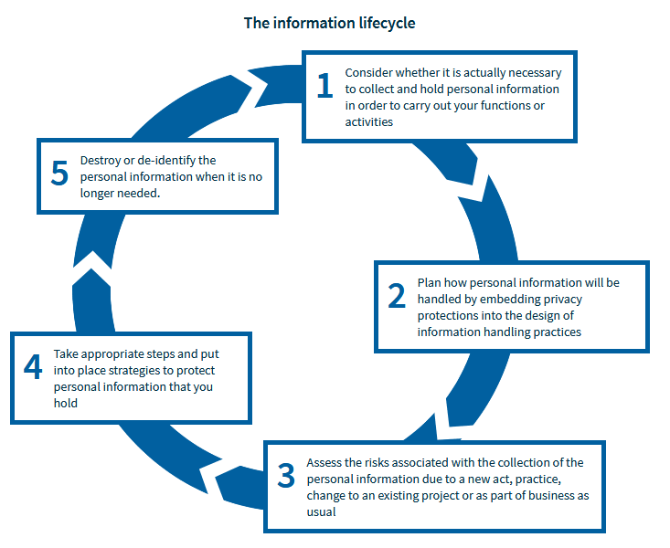
Personal information security

Slide 29
Q and A
Links to resources:
Privacy Management Framework: https://www.oaic.gov.au/agencies-and-organisations/guides/privacy-management-framework
Guide to securing personal information: https://www.oaic.gov.au/agencies-and-organisations/guides/guide-to-securing-personal-information

